Slide 1
ACS CAN Washington
Cancer Action Day
Pre-Training
Notes:
We want to talk about the work ACS CAN does and how you can get involved.
Raise your hand if you’re involved. Nice!
It’s a real pleasure to meet you. It says a lot about all of you that you’ve made room in your college experiences to make a difference for cancer patients and their families. To the extent that you haven’t worked with ACS CAN or just started doing so, I think there are real opportunities to do some big things together.

Slide 2
What we’ll cover today
1
What to Expect at Cancer Action Day, Our Goals & Purpose
2
Reviewing Our Asks & Priorities in Olympia
3
Legislative Meeting Review & Planning
4
Homework/Meeting Prep & Resouces Review
5
Questions & Close
#WALeg
#CancerActionDay
Notes:
Briefly review agenda/objectives

Slide 3
Our Goals & Purpose
Notes:
Briefly review agenda/objectives

Slide 4
Where, When, How

Slide 5
Where: Sunday Evening | February 2nd
1.
3.
1.Check-In Hotel, Double Tree Olympia, 4:00 p.m.
2. Lights of Hope Washington, Heritage Park, 5:30 p.m. - 6:30 p.m.
3. Team Dinner, Well80, 514 4th Ave E, Olympia,
7 p.m.
2.
#WALeg
#CancerActionDay
Notes:
Briefly review agenda/objectives

Slide 6
When: Time of Events
#WALeg
#CancerActionDay
8:30 a.m.
9:00 a.m.
9:10 a.m.
9:15 a.m.
9:45 a.m.
10:15 a.m.
10:25 a.m.
10:30 a.m.
10:35 a.m.
11:30 a.m.
4:30 p.m.
Check In, Breakfast
Captiol Room, Double Tree Olympia
Welcome: Our Plan and Purpose
Survivor Recognition
Legislative Overview: What does the process look like in Olympia? What is on our legislative agenda?
Legislative Meeting Training: What to expect, how to structure your meetings & a few examples
Using Social Media as a Tool Today
#WALeg #CancerActionDay
How to Fight Beyond Today: Let’s Talk About Legislative Ambassadors
Group Photo & Bathroom Break
Breakout Meeting Prep w. Team Leaders
Head to the Capitol - Meetings & Lunch
Meetings with Lawmakers & Staff
Capitol Campus & Dome Dei - Lunch available at Noon
Meetings End & Capitol Room Closes
Report Back Forms, Thank You Notes, Debrief & Social Media Actions - Anytime
Captiol Room, Double Tr﻿ee Olympia
Notes:
Briefly review agenda/objectives

Slide 7
Where: Monday | February 3rd
1.
1. Double Tree Olympia, Capitol Room: Opening Breakfast 8:30 a.m.
2. Washington State Capitol Campus, Legislative Meetings & Lunch, 11:30 - 4:30 p.m.
2.
#WALeg
#CancerActionDay
Notes:
Briefly review agenda/objectives

Slide 8
How: Navigating to the Capitol & Back
Intercity Transit to Capitol Campus - Route 14, Map Link in Hub
Plan your route with your team Monday morning of CAD
Familiarize yourself with the route and timing now
Passenger Van Optional
#WALeg
#CancerActionDay
Notes:
Briefly review agenda/objectives

Slide 9
Where: Capitol Campus
Legislative Meetings
Legislative Building
John L. O’Brien
John A. Cherberg Building
Irv Newhouse Building
Add. Imp. Locations
ADA Building Entrances
Limited Parking
Dome Deli - Legislative Building (Find an ACS CAN team member with supplies & Lunch)
#WALeg
#CancerActionDay
Notes:
Briefly review agenda/objectives

Slide 10
A Few Other Event Details
1
Travel Reimbursement
2
What to Wear
3
Utilizing the Participant Hub
#WALeg
#CancerActionDay
Notes:
Briefly review agenda/objectives

Slide 11
#WALeg
#CancerActionDay
Notes:
Briefly review agenda/objectives

Slide 12
Reviewing our Asks & Process in Olympia

Slide 13
Priority #1
Biomarker Testing Coverage
HB 1062 | Access to the Precision Therapy
Ask: Will you support HB 1062?
#WALeg
#CancerActionDay
Notes:
Highlight state priorities

Slide 14
Priority #2
End the Sale of Menthol & Flavored Tobacco
HB 1203/SB 5183| Prevent Washington Kids &
Advance Health Equity
Ask: Will help end the sale of menthol & flavored tobacco
Fact Sheets &
Resources
@ the Hub
#WALeg
#CancerActionDay
Notes:
Highlight state priorities

Slide 15
Legislative Process in Olympia: Overview
Where is our bill??
House Health Care & Wellness
House Appropriations Committee
Do it all over again in the Senate!
House Floor
#WALeg
#CancerActionDay
Notes:
Highlight what impact would be made if policy was passed

Slide 16
Lawmaker Meetings

Slide 17
What to Expect, A few Tips
What to Expect in a Legislative Meeting
Tips for Meeting with Staff, Target Lawmakers & Champions
Leading With Your Story
Hook, Line & Sinker
#WALeg
#CancerActionDay
Notes:
Highlight what impact would be made if policy was passed

Slide 18
Lead with Your Story

Slide 19
Hook, Line, Sinker
Hook
Line
Sinker
Thank You
Who You Are
What Is Your Story
The Request
Appreciation
#WALeg
#CancerActionDay
Notes:
Highlight what impact would be made if policy was passed

Slide 20
Hook, Line, Sinker
Meeting leader introduces the group (name + where you live) and why you are here.​
I am here as a volunteer for ACS CAN. We are meeting with nearly every Member of the Washington Legislature. ​
​
We would like your support on the passage of HB 1062?
Explain the need: (INSERT why this is needed/impact on state/why important for cancer etc.)​
Tell your personal story: Connect your personal story to the importance of the ask/issue.
Make the ask!
Hook
Line
Sinker
#WALeg
#CancerActionDay
Notes:
Highlight the impact of following ACS CAN on social media and amplifying our mission through connections

Slide 21
Post Meeting Actions
1
Thank You Emails & Notes : Resources at CAD& Hub
2
Report Back on Legislative Meetings
3
Social Media & Letters to the Editor
4
Bingo!
#WALeg
#CancerActionDay

Slide 22
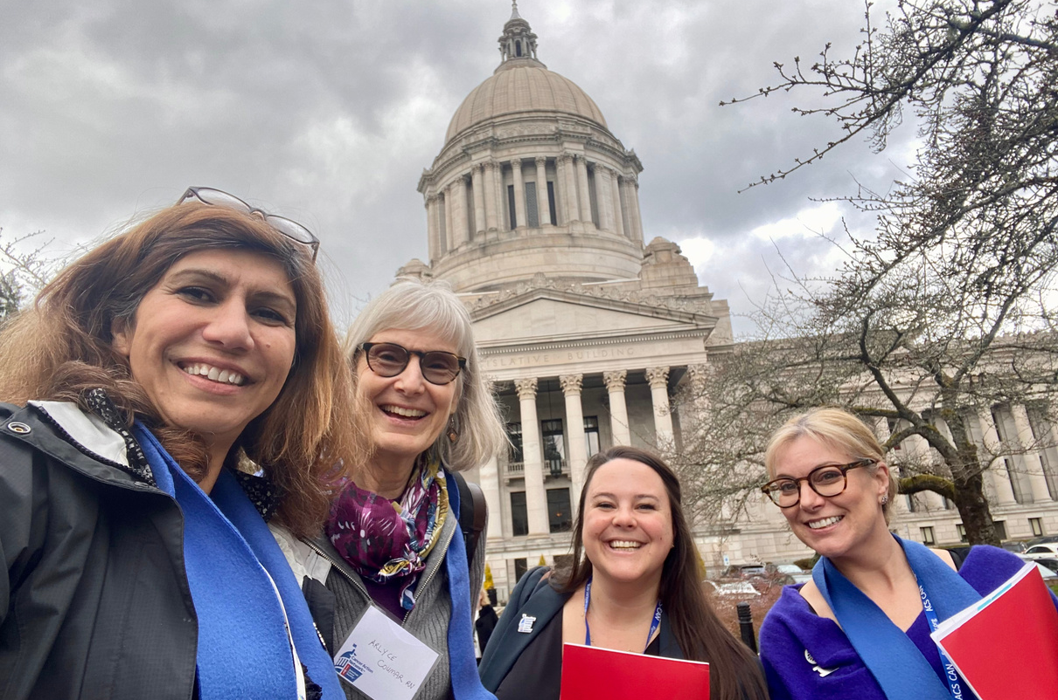
Report Back on your Legislative Meetings
Report back and let us know how your meeting went
Your feed back helps our staff provide additional information to lawmakers and make strategic decisions in successful campaigns.
Remember: One report back form should be completed for each lawmaker meeting
Scan the QR code or visit:
https://act.fightcancer.org/a/acs-can-report-back-form
Notes:
Highlight what Cancer Action Day looks like to your state

Slide 23
Let’s Takeover Social Media
Make a post before Cancer Action Day, ex. getting ready!
Post after your meetings!
Tag your lawmaker
#WALeg #CancerActionDay
Share your experience & the Ask
Bring Your Laptops for posts & thank you emails after meetings
#WALeg
#CancerActionDay
Notes:
Highlight what Cancer Action Day looks like to your state

Slide 24
Bingo
Post and be active on social media by participating in Bingo
#WALeg
#CancerActionDay
Notes:
Highlight what Cancer Action Day looks like to your state

Slide 25
Homework/Meeting Prep & Resources Review

Slide 26
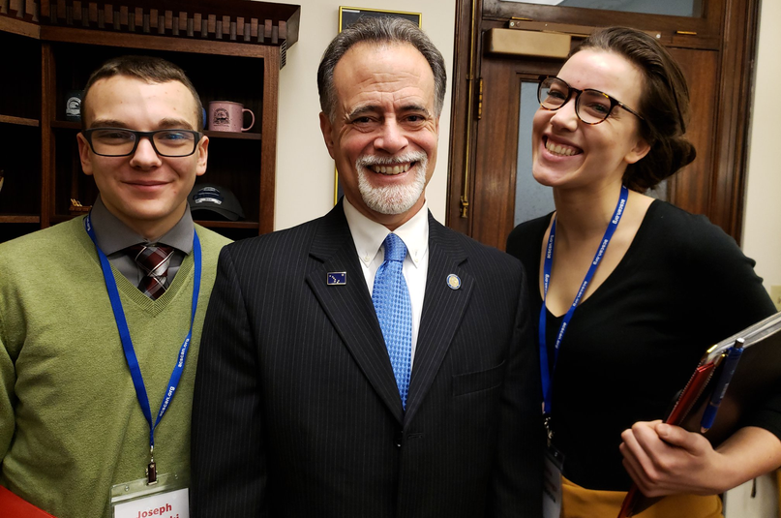
Meeting Prep: How to Make the Most out of your Legislative Meetings
Power Analysis, Why?
Finding Your Lawmakers
#WALeg
#CancerActionDay
Notes:
Highlight what Cancer Action Day looks like to your state

Slide 27
Most importantly..... don’t forget to HAVE FUN!
#WALeg
#CancerActionDay
Notes:
Highlight what Cancer Action Day looks like to your state

Slide 28
Q&A

Slide 29
Thank You
©2023, American Cancer Society Cancer Action Network, Inc.

