Slide 1

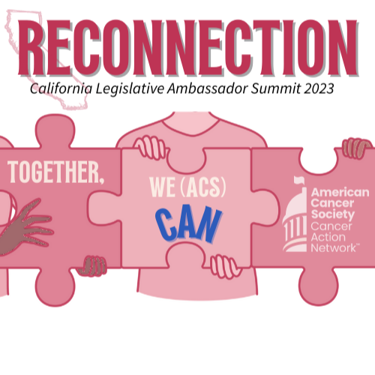

WELCOME
Kay Coleman
State Lead Ambassador

Slide 2





Appreciated your support in 2022

Slide 3
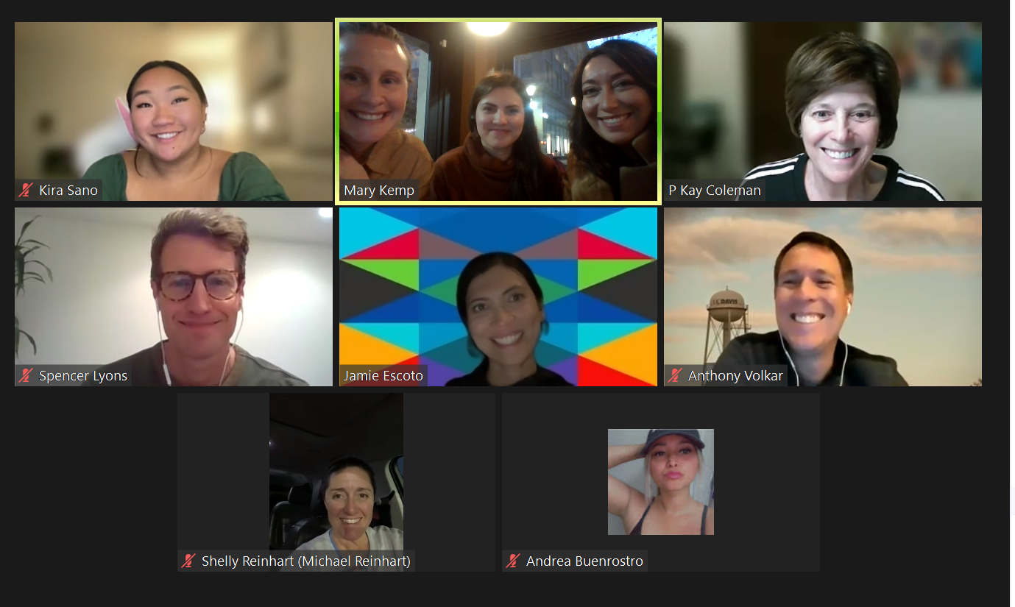
Appreciated your support in 2022

Slide 4
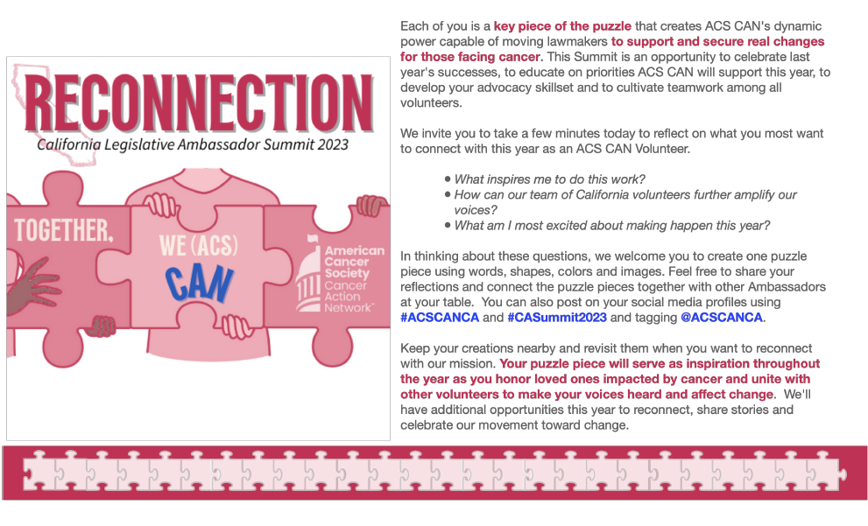

Slide 5
State of Federal ACS CAN
& 2023 Federal Priorities
Tammy Boyd, Jr.
Vice President, Federal Advocacy and Strategic Alliances
ACS CAN
James Williams, Jr.
Director, Federal Relations, Cancer Prevention,
Early Detection and Screening
ACS CAN

Slide 6




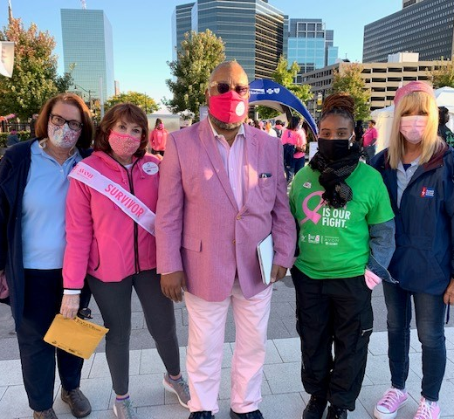
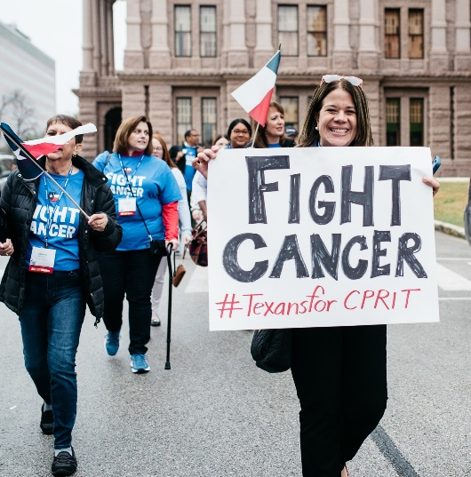
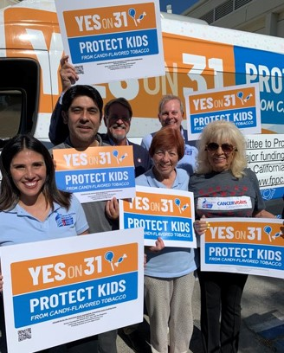

Our Policy Areas in Broad Strokes
Access to Care
Accelerating Cures
Prevention, including Tobacco Control
Eliminating Disparities + Building Health Equity

Slide 7
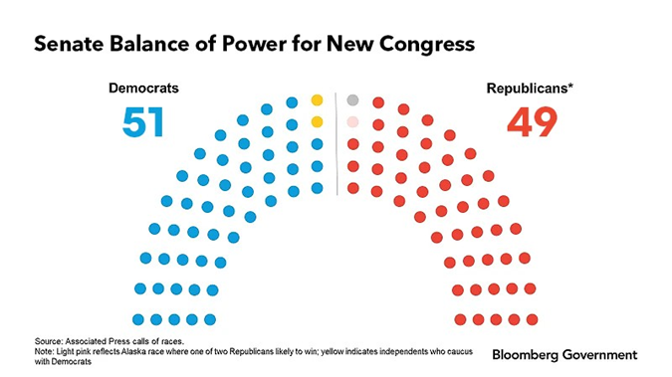
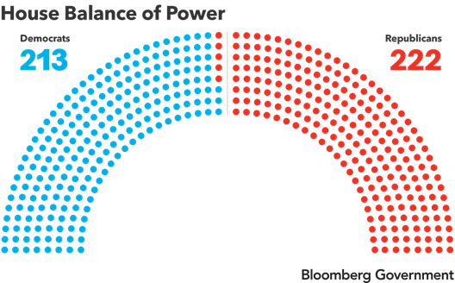
The 118th Congress: What to Know
Balance of Power
  Senate: 51 Democrats, 49 Republicans
  House: 222 Republicans, 213 Democrats
Diversity in Congress
House Republican Majority focus on discretionary spending caps and budget cuts
The small margins in the balance of power is critical to all of this

Slide 8

2023 Federal Priorities
Tier 1: Major Campaigns
Tier 1 issues are “all hands on deck.” These campaigns typically include
nationwide grassroots, grasstops, media advocacy, and other resources as needed.
Tier 2: Targeted Campaigns
Tier 2 issues are limited in scope, with grassroots activities and other resources deployed in targeted districts.
Tier 3: Additional Federal Policy Priorities
Tier 3 issues are emerging or evolving. These issues will likely transition into
Tier 2 or Tier 1 as they develop and pathways for movement materialize.

Slide 9

2023 Federal Priorities
Tier 1: Major Campaigns
Cancer Research & Prevention Funding (Fiscal Year 24) – NIH, NCI & CDC
Access to Clinical Trials
Cancer Prevention, Early Detection and Screening
Tier 2: Targeted Campaigns
Health Insurance Reform
Patient and Survivor Quality of Life
Diagnostic Reform
Tobacco Control
Tier 3: Additional Federal Policy Priorities
Childhood Cancer
Patient Navigation
Firefighters and Cancer Risk
Indian Health Services
Veterans’ Health Care
Health Equity
Caregiving

Slide 10
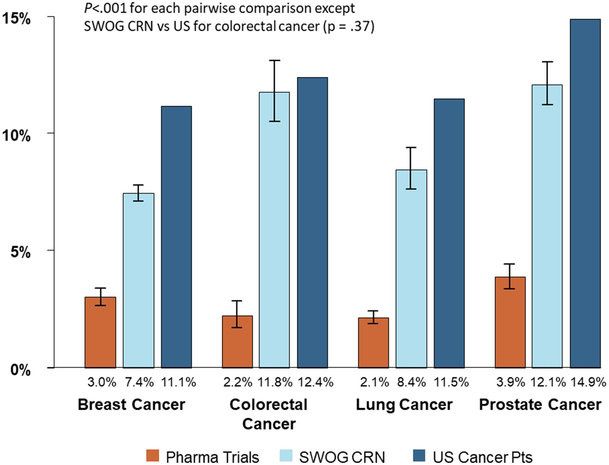
Disparities
Proportion of Black patients by research setting and for the US cancer population for common cancers.
Incidence of prostate cancer is 73% higher in non-Hispanic Black men than in non-Hispanic White men for reasons that remain unclear¹
Black men have the highest death rate for prostate cancer of any racial or ethnic group in the US, 2 times higher than White men¹
Although there is some evidence that aggressive prostate cancer is more common in Black men, the larger disparity for mortality than incidence largely reflects less access to high-quality treatment¹
Access to care is an important determinant of racial equity²
  Access to Care includes support for the Prostate Specific Antigen Screening for High Risk Insured Men (PSA for HIM) Act
[1] American Cancer Society. Cancer Facts & Figures for African American/Black People 2022-2024.
[2] Riviere, P., Luterstein, E., Kumar, A., Vitzthum, L. K., Deka, R., Sarkar, R. R., Bryant, A. K., Bruggeman, A., Einck, J. P., Murphy, J. D., Martínez, M. E., & Rose, B. S. (2020). Survival of African American and non-Hispanic white men with prostate cancer in an equal-access health care system. Cancer, 126(8), 1683–1690. https://doi.org/10.1002/cncr.32666
JNCI Cancer Spectr, Volume 4, Issue 4, August 2020, pkaa034, https://doi.org/10.1093/jncics/pkaa034
The content of this slide may be subject to copyright: please see the slide notes for details.

Slide 11
Medicare Multi-Cancer Early Detection and Screening Act (MCED)
Provides a pathway for Medicare coverage of multi-cancer early detection screening tests through the National Coverage Determination Process
  It is NOT a coverage mandate. It simply enables Medicare to determine if coverage is appropriate
Multi-cancer early detection screening tests
  Must be approved or cleared by the FDA
  Used for early detection of many cancer types
  A simple blood draw is all it takes

Slide 12
PSA Screening for HIM Act
The Prostate-Specific Antigen Screening for High-risk Insured Men (PSA Screening for HIM) Act would waive deductibles, copayments and coinsurances for prostate cancer screenings for high-risk men -- those who have a family history of prostate cancer or who are African-American.
ACS CAN supports this legislation which is expected to be re-introduced on a bi-partisan basis within the next week.
This is one of ACS CAN’s top issues addressing health disparities among Americans.

Slide 13
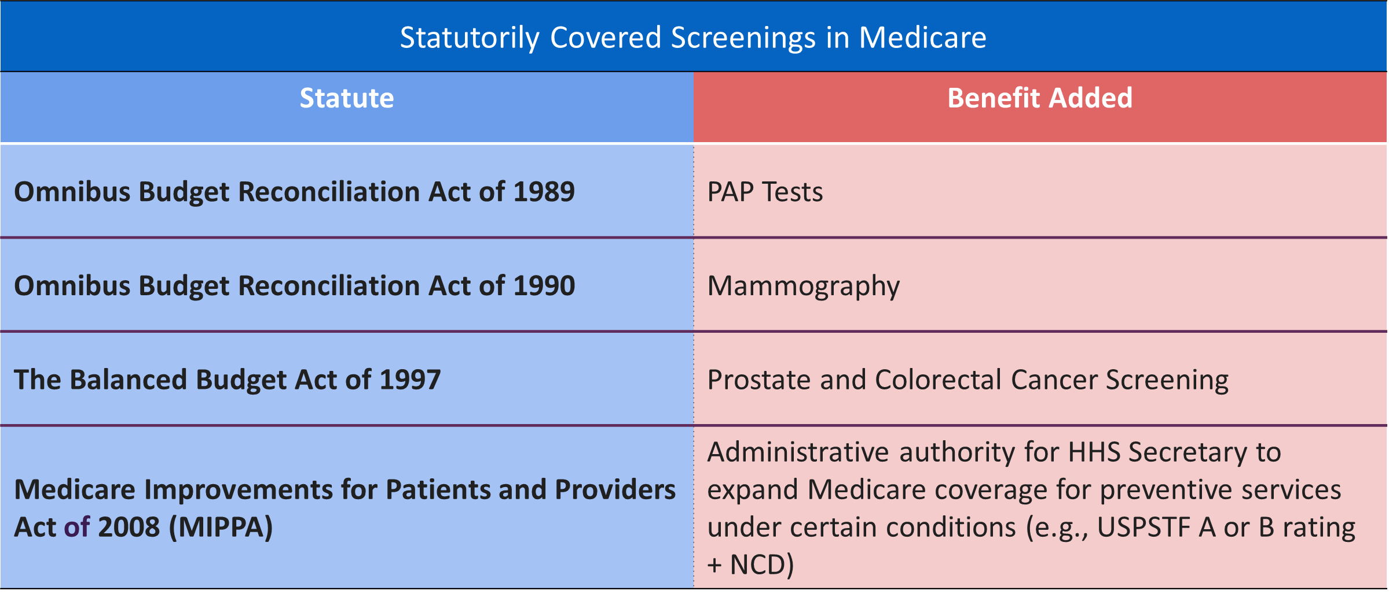
The Challenge: Medicare Does Not Cover Cancer Screenings Except Where the Law Has Been Amended to Provide Coverage

Slide 14
California State & Local
2022 ACCOMPLISHMENTS
2023 State Priorities
Jim Knox
Managing Director California/Hawaii
ACS CAN

Slide 15
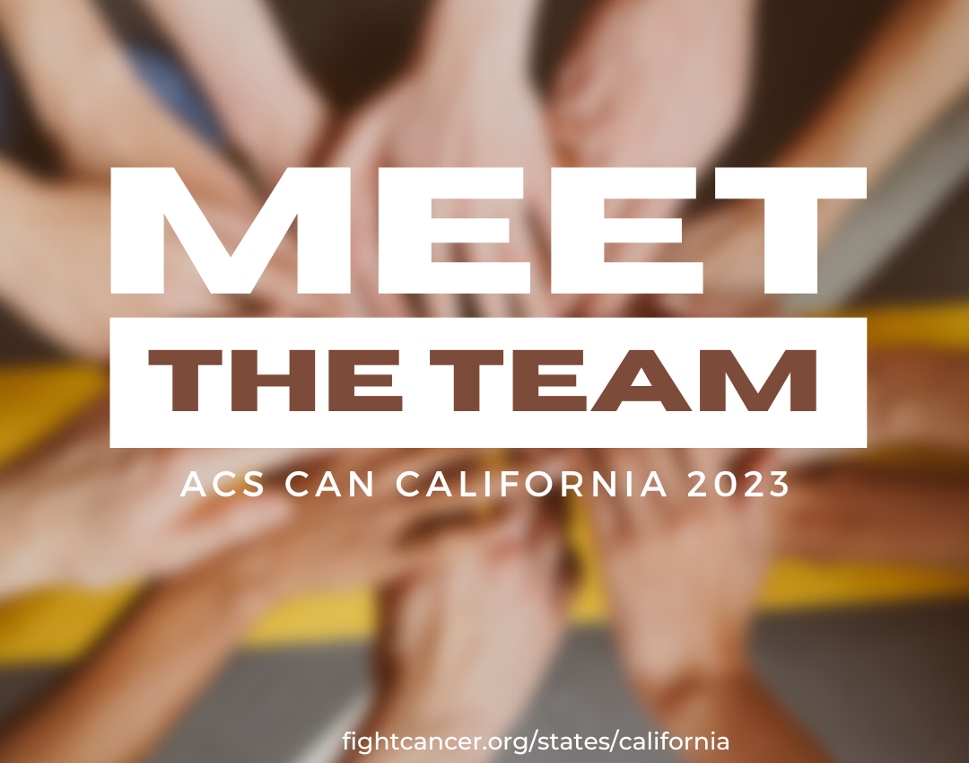

Slide 16

GRASSROOTS

Slide 17

GOVERNMENT RELATIONS

Slide 18
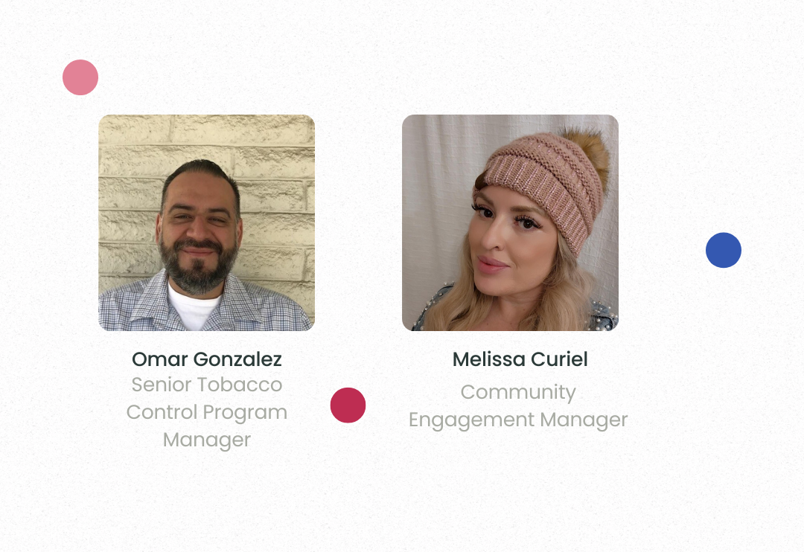

VIVE

Slide 19
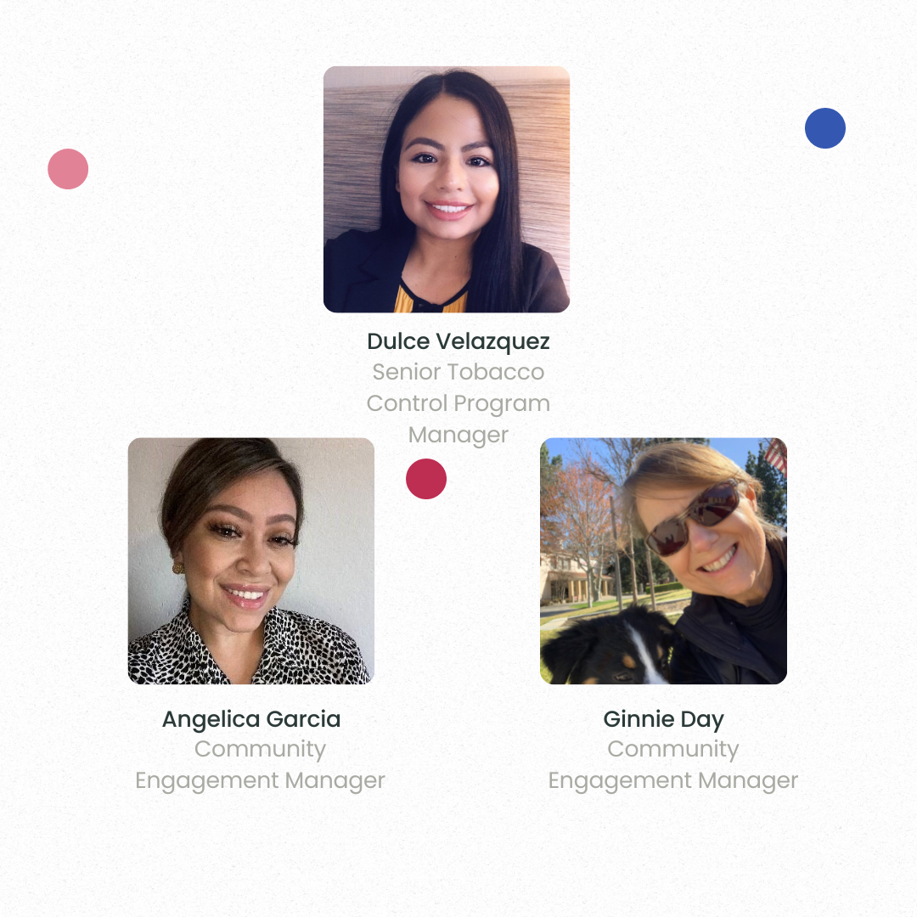

VIVA

Slide 20
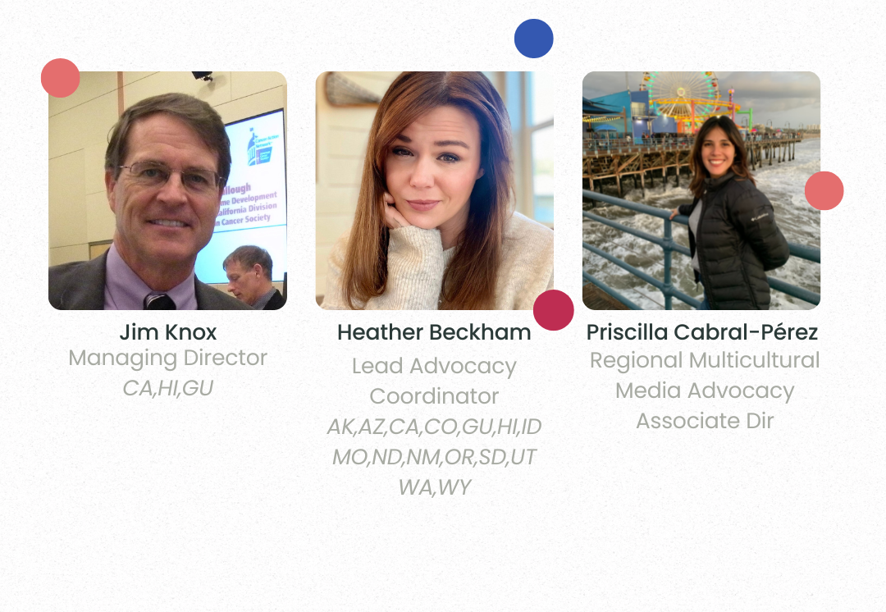
REGIONAL STAFF

Slide 21
2022 LOCAL TOBACCO WINS
Smoke-Free Multi-
Unit Housing
Alameda County
Riverside
San Fernando
Sierra Madre
Vallejo
Defeated Bad SFMUH
San Jose
Smoke-Free
Outdoors
El Monte
Palmdale
San Diego Co.
Minimum Price/
Minimum Pack Size
Antioch
Pleasant Hill
Tobacco-Free
Pharmacies
Antioch
Pacifica
Tobacco Retail
Restrictions/Fees
Indio
San Diego County

Slide 22
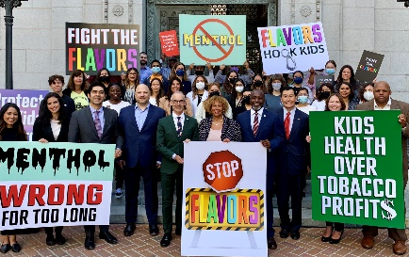
2022 FLAVORED TOBACCCO BANS
Antioch
Chula Vista
Foster City
Goleta
Hollister
Los Angeles
Monterey County
Moraga
Orinda
Pacifica
Pico Rivera
Pleasant Hill
Rancho Cordova
Sacramento County
San Benito County
San Diego
San Juan Bautista
San Leandro
Santa Ana
Saratoga
Soledad
Walnut
Los Angeles City Hall

Slide 23
LOCAL VOLUNTEER POWER
Kian Ghasemi
Willie Goffney
Bob Gordon
Pam Granger
Olivia Hamblin
Bob Heinbaugh
Paul Hinrichsen
Ken Housfeld
Aditya Indla
Carolyn Katzin
Agamroop Kaur
Laura LaRose
Tish Leon
Alison Levy
Celina Lopez
Elizabeth Martin
Carlos Martinez
Cameron Meyer
Josue Mendoza
Vanessa Mendoza
Janice Montle
Jim Murphy
Jesse Nodora
Nadian Oudeh
Liseth Pacheco
Lizette Palacios
Melissa Park
Savino Perico
Ananya Pinnamaneni
Ujwala Rajgopal
Jose Ramos
Carolyn Rhee
Sylvia Rios
Patsy Romero
Bernice Sanders
Isha Sarkar
Zach Schlagel
Kiera Schminke
Stefania Sesock
Linda Shaner
Hortencia Silva
Yissel Silva
Krupa Singampalli
Charlie Smith
Tracy Steuckrath
Holly Tenaglia Santos
Paula Tyner
Aayush Verma
Varshini Vijay
Ilda Zepeda
Anthony Volkar
Adilene Arizaga
Carol Baker
Tricia Barr
Bea Cardenas-Duncan
Jorge Chavez
Kay Coleman
Dawn Correll-Cruz
Denis Ducey
Virginia Escamilla
Jamie Escoto
Linda Evans
Stephanie Fajuri
Kathy Flaherty
Israel Fuentes
Jessica Garcia
Jackie Gash

Slide 24
LOCAL FLAVORED TOBACCO

Slide 25
2022 BIG STATE WIN
YES 63.4% No 36.6%
46,000 smokers would quit as a result of the policy (5.6% of menthol smokers)
10,700 premature smoking-caused deaths avoided
More than $819 million in annual health care cost savings, including $283.6 million in MediCal savings
Net increase of 3,322 jobs and $580.8 in California economic activity and associated state and local tax revenues.
Chaloupka, F. J. and Glantz, S.A. Potential Effects of a Ban on the Sale of Flavored Tobacco Products in California, University of Illinois at Chicago, 2021.

Slide 26
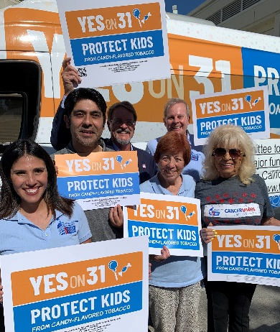
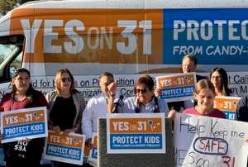
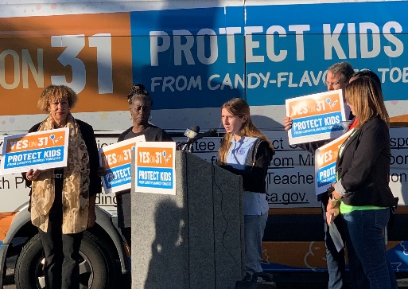
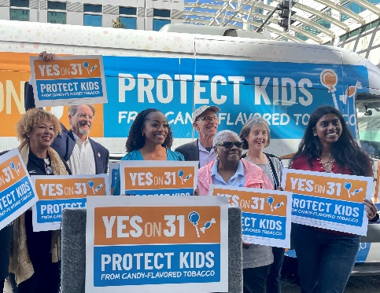
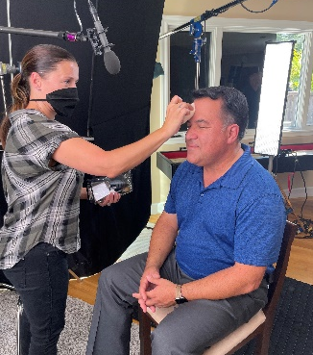
2022 BIG STATE WIN
46,000 smokers would quit as a result of the policy (5.6% of menthol smokers)
10,700 premature smoking-caused deaths avoided
More than $819 million in annual health care cost savings, including $283.6 million in MediCal savings
Net increase of 3,322 jobs and $580.8 in California economic activity and associated state and local tax revenues.
Chaloupka, F. J. and Glantz, S.A. Potential Effects of a Ban on the Sale of Flavored Tobacco Products in California, University of Illinois at Chicago, 2021.
Bakersfield
Fresno
Oakland
Video prep
Los Angeles

Slide 27
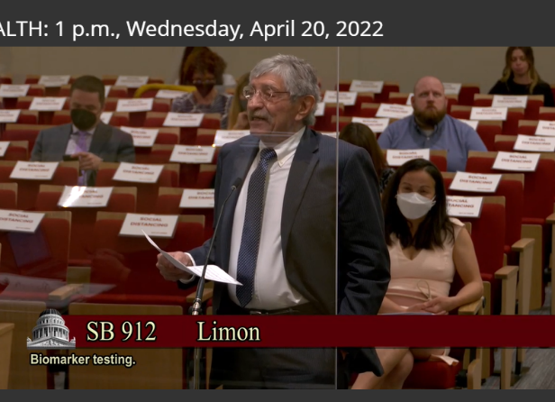
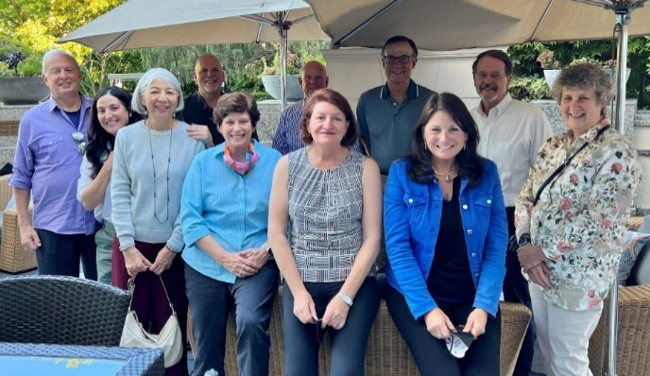
2022 STATE LEGISLATION
Access to NCI Cancer Centers for Medicaid Patients
SB 987 Passed and Signed
Coverage for Biomarker Testing
SB 912 Passed and Vetoed
.
Dr. Pete Cala testifies on SB 912
CLC meets with Senate President Atkins on SB 912

Slide 28

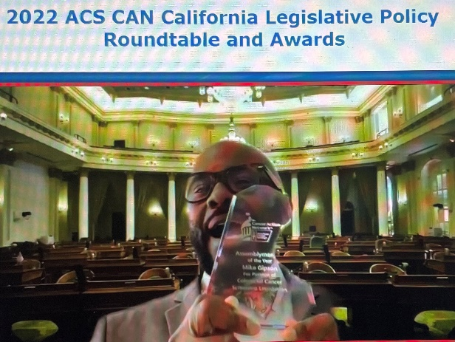
2022 FUNDRAISING
Asm. Gipson accepts Legislator of Year Award
Policy Events $130K goal… $145K actual !
Lights of Hope $75K goal… $ 86K actual !
Discovery Shops $63K goal… $ 63K actual !

Slide 29


2023 LOCAL PRIORITIES
Flavored tobacco enforcement
Riverside/San Bernardino/ Imperial Hispanic/Latino grant
Rural Central Valley grant
NEW GRANTS !!

Slide 30
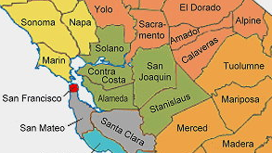
2023 LOCAL PRIORITIES
2 new local tobacco control grants
$640K each May 2023 – June 2025
Hispanic Latino –
Solano & Stanislaus Counties
African American –
Alameda & Contra Costa Counties
4 new staff to be hired!

Slide 31
2023 STATE PRIORITIES
Coverage for biomarker testing (SB 496)
California Cancer Registry (SB 344)
Oral chemo parity reauthorization (SB 421)
Flavored Tobacco enforcement
Protecting smoke-free laws/Cannabis
…more to come

Slide 32
2023 FUNDRAISING GOALS
Policy Events $130K goal
June 24, 2023
California Legislative Policy Roundtable
  Legislative Awards & CA Cancer Registry
October 5, 2023
Health Equity & Cancer Screening Policy Forum
Lights of Hope $80K goal
Discovery Shops $63K goal

Slide 33
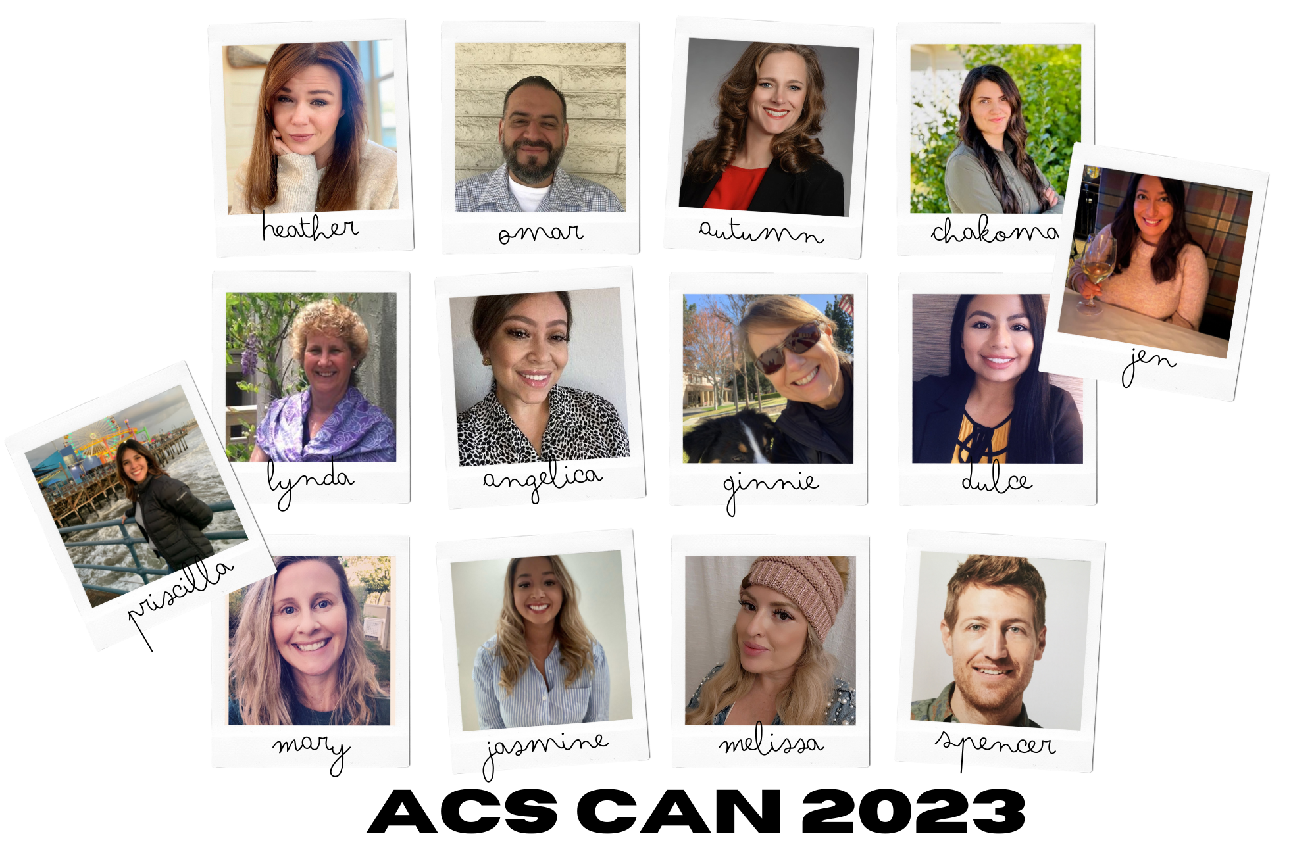
THANK YOU !

Slide 34
Patricia A. Ganz, M.D.
Health Policy & Management and Medicine
UCLA Fielding School of Public Health
The Importance of
Cancer Registries
Patricia A. Ganz, M.D.
Health Policy & Management and Medicine
UCLA Fielding School of Public Health
Philip H. G. Ituarte, Ph.D., M.P.H.
Assistant Research Professor Department of Surgery
City of Hope
Dr. Loraine Escobedo, PhD, MPH
Project Scientist, Catchment Area Data and Research
Cedars-Sinai
Moderated by:
Lance Barbour
Director, State & Local Campaigns - Health Equity
ACS CAN

Slide 35
Using the Cancer Registry to Facilitate Research
Patricia A. Ganz, MD
Disinguished Professor, UCLA Schools of Medicine and Public Health
American Cancer Society Clinical Research Professor
ACS CAN meeting February 15, 2023

Slide 36
How to use cancer registry for research
There are multiple ways the registry can help with research
How many patients with a specific type of cancer have been diagnosed in California in the past 5 years?
What is their age, stage distribution, and type of treatments?
How can this information be helpful?
  You want to open a clinical trial. Are there enough patients with this diagnosis/potentially eligibile to make it feasible?
  You are interested in the quality of care in Los Angeles. Did patients receive treatment in a timely fashion and was it guideline concordant?
  You are writing a grant to study cancer survivors and need to know if there will be enough patients at in your hospital to support the research.
IRB approval is not necessary to obtain this type of information from the cancer registry.

Slide 37
How to use cancer registry for research
There are multiple ways the registry can help with research
Your grant was funded based on knowing that there were sufficient cancer survivors to survey. You now need to contact them.
  With IRB approval, the cancer registry can provide identifiable information on patients who meet the eligibility for your study.
  You need to request the specific information that you need about the disease and treatment, as well as contact information required
  Specific language must be provided in your recruitment letter saying that you received their information from the cancer registry and that this is legally allowed with IRB approval.

Slide 38
How to use cancer registry for research
There are multiple ways the registry can help with research
You need to identify cancer patients soon after diagnosis for an epidemiological study or a quality of care study. Can the cancer registry help with this?
  Rapid case identification is available through the registry, but there is a fee associated with this.
  IRB approval will be necessary for this type of research.
  Many studies have been conducted by UCLA investigators using this mechanism.

Slide 39
How to use cancer registry for research
There are multiple ways the registry can help with research
California statewide data are very valuable for quality of care research as well as to maximize the diversity of patients included in a study
Many researchers have merged insurance claims data with cancer registry data to understand how type of health insurance or lack thereof influences outcomes
IRB approval is generally required to allow matching, and this is often done by the registry staff for a fee
We are hoping to see merged data in California, as has been done nationally and in some other states, so that we can understand barriers and facilitators of quality care

Slide 40
Advantages and Limitations
Advantages
Access to well-characterized samples of cancer patients with potential to contact them for research if IRB approval is obtained.
Opportunity to better understand the characteristics of patients being treated for cancer in a particular geographic location and where there may be greatest need for future research
If you either recruit for in-person study or survey, you can characterize who did and did not participate in your study. Was there a response bias?

Slide 41
Advantages and Limitations
Limitations
Cancer registry data availability is usually delayed by 1-2 years
IRB approval process and release of data can take time
For some studies, there may be costs associated with request for data (depending on registry) as well as merging of data.
In spite of the legality of obtaining patient identifiers and inviting patients to participate in a research study, some people have raised concerns about privacy related to this information.

Slide 42
Questions?
pganz@mednet.ucla.edu

Slide 43

Gynecologic oncology cancer survival and its association with residing in food deserts
Philip H.G. Ituarte, PhD MPH; Nicole Lugo Santiago, MD; Shiva Hadadianpour, MD; Adrian Kohut, MD; Rosemary Senguttuvan, MD; Ana Tergas, MD MPH; Lorna Rodriguez-Rodriguez, MD PhD; Mihae Song MD
Department of Surgery, City of Hope National Medical Center
Notes:
The talk I’m presenting today is based on a recent study using the California Cancer Registry data from 2013 to 2019. This study will be presented at the Annual Meeting of the Society for Gynecological Oncologists in March of this year. The study explores the relationship between mortality associated with site-specifi cancers and patient residence in food deserts.

Slide 44
USDA Food Desert Definition
Low income
Distance to food
Poverty rate ≥20%
A family income not exceeding 80% of the census tract median family income
Urban:
  1 mile
Rural:
  10 miles
Notes:
The US Department of Agriculture defines a food desert by 2 factors: (1) living in a census tract associated with low income, and (2) living in a census tract where the closest market (not a 7-11!), is 1 mile or more distant for urban areas, or 10 miles or more for rural areas.

Slide 45
Health and Living in a Food Desert
Cardiovascular health
Associated with cardiovascular health risk in young adults (Testa, 2021)
Obesity
Distance to store and prices were positively associated with obesity (Ghosh-Dastidar, 2014)
T2DM
Food insecurity is associated with a higher HbA1c (Berkowitz, 2018)
Obstetrical and neonatal outcomes
Obstetrical complications: maternal anemia, gestational diabetes mellitus, pregnancy-induced hypertension disorders, pre-labor rupture of membranes, preterm birth (Pires Augusto, 2020)
Neonatal complications: low birth weight, newborn impaired cognitive development, newborn mortality including fetal and structural abnormalities (Tipton, 2020)
Notes:
Studies have established a link between food deserts and worse health (or greater health risk), including greater risk of cardiovascular disease, obesity, higher rates of diabetes, and birth-related complications, both for the pregnant women and for newborns.

Slide 46
California Cancer Registry
(CCR)
2013-2019
USDA Food Access Research Atlas
Office of Statewide Health Planning and Development
(OSHPD)
Demographics
Treatment
Survival
Covariates
Food desert residential status by census tract
Compare patients with cervical, endometrial, and ovarian cancer by food desert residential status
Notes:
We used the California Cancer Registry data to identify a subset of women with cancers of the cervix, the endometrium (i.e., the lining of the uterus), and the ovaries. Census tract of patient residence at time of diagnosis was linked to USDA data set identifying food-desert census tracts. In addition to these links, the CCR data was also linked to the Office of Statewide Health Planning & Development data set of inpatient hospital records linked to CCR by unique patient ID number. The inpatient data contains codes representing specific diagnoses or procedures CCR patients may receive during hospitalization for cancer surgery and other treatments. These codes are used to capture patients diagnosed with co-occurring cancer risk factors such as smoking, and chronic conditions associated with diet, including obesity, diabetes, or metabolic syndrome.

Slide 47
6%
Notes:
A relatively small percentage of cases live in food deserts.

Slide 48
Statistical Models for Survival Time
 | CERVICAL CANCER | ENDOMETRIAL CANCER | OVARIAN CANCER
AGE
RACE
COMORBIDITY
INSURANCE
SOCIOEOCNOMIC STATUS
STAGE
SURGICAL TREATMENT
CHEMOTHERAPY (no/yes)
RADIATION (no/yes)
SMOKING (no/yes)
OBESITY (no/yes)
DIABETES TYPE II (no/yes)
FOOD DESERT (no/yes)
Notes:
I created statistical models that adjusted for factors other than food desert residence that are known to affect cancer survival. These included age, race, comorbid conditions, type of insurance, socioeconomic status, cancer stage, and cancer treatments, including surgery, chemotherapy, or radiation. In addition, I adjusted for patients who smoked or who had diet related diagnosies like obesity or diabetes type II.

Slide 49
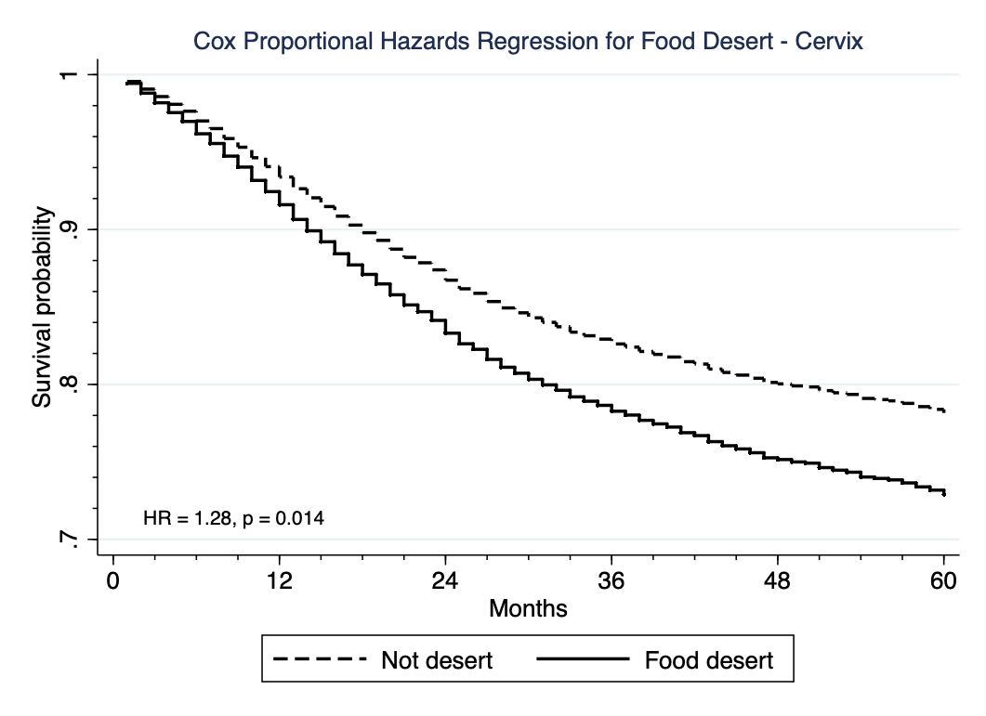
Cervical Cancer: 28% greater mortality risk
Notes:
Adjusting for these other known predictors of cancer survival, food desert residence was significantly associated with decreased survival time over a period of 5 years for patients with cervical cancer. Here the solid black line indicates that food desert residents have a 28% greater mortality risk compared with non-desert residents.

Slide 50
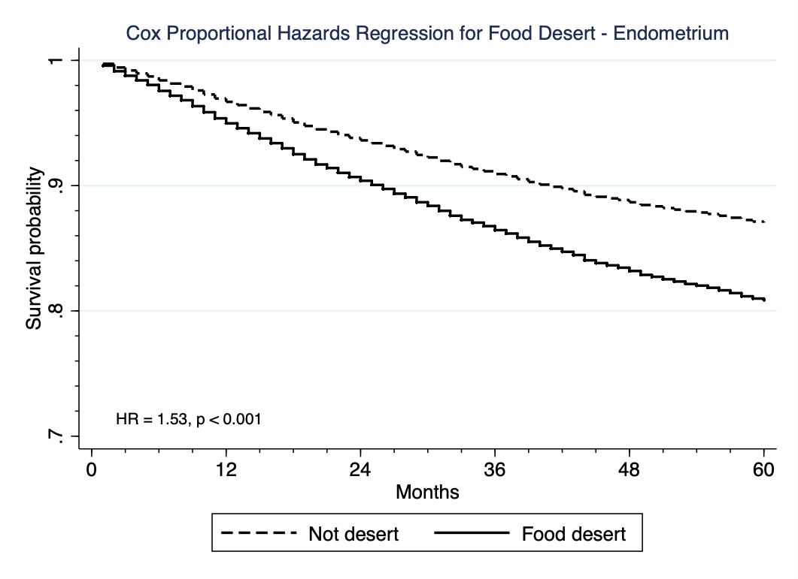
Endometrial Cancer: 53% greater mortality risk
Notes:
Food desert residence was significantly associated with decreased survival time over a period of 5 years for patients with endometrial cancer. Here the solid black line indicates that food desert residents have a 53% greater mortality risk compared with non-desert residents.

Slide 51
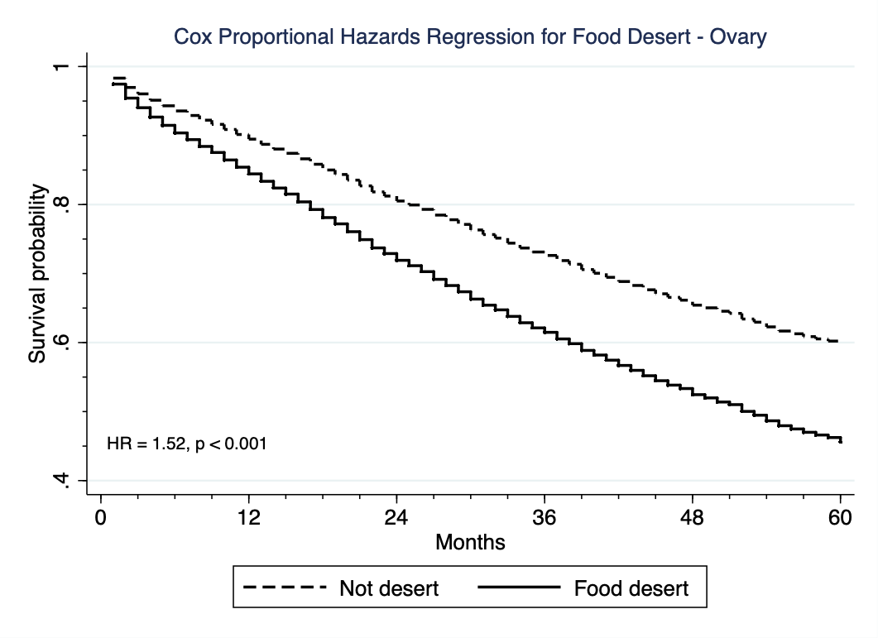
Ovarian Cancer: 52% greater mortality risk
Notes:
And again, for ovarian cancer patients, food desert residence was significantly associated with decreased survival time over a period of 5 years for patients. Here the solid black line indicates that food desert residents have a 52% greater mortality risk compared with non-desert residents.

Slide 52
Food deserts are associated with decreased survival in patients with gynecologic cancers
Future studies are needed to know why this association is observed

Slide 53
Strengths of CCR Based Research
CCR data may be supplemented with OSHPD inpatient data to yield valuable clinical information about patients: diagnoses of smoking, obesity, diabetes, metabolic syndrome, and other chronic conditions
CCR data may be linked by census tract to freely available CA state and US federal data sets like US census data, environmental pollution data, or social data on neighborhood segregation or access to public transportation
Huge untapped potential for analysis of multiple individual, neigbhorhood, environmental and societal factors affecting cancer diagnosis, treatment, and outcomes
Notes:
Add more

Slide 54
Notes:
For each of the 58 California state counties, we determined the percentage of food desert census tracts relative to all census tracts and plotted this information on a map. The darker green counties have a higher percentage of food desert census tracts. You will note that counties that are largely rural (like Imperial County on the lower right), or those that are largely desert (like Inyo County on the middle right), or areas isolated by forest and mountains (the counties in the upper part of the state) are more densely green, and therefore more “desert”-like.

Slide 55
References
Pires Augusto AL, de Abreu Rodrigues AV, Barbosa Domingos T, et al. Household food insecurity associated with gestational and neonatal outcomes: a systematic review. BMC Pregnancy Childbirth. 2020;20(1):229. https://doi.org/10.1186/s12884-020-02917-9
Tipton MJ, Wagner SA, Dixon A, et al. Association of living in a food desert with pregnancy morbidity. Obstet Gynecol. 2020;136(1):140–145
Testa A, Jackson DB, Semenza DC, Vaughn MG. Food deserts and cardiovascular health among young adults. Public Health Nutr. 2021 Jan;24(1):117-124. doi: 10.1017/S1368980020001536. Epub 2020 Jul 9. PMID: 32641177
Ghosh-Dastidar B, Cohen D, Hunter G, Zenk SN, Huang C, Beckman R, Dubowitz T. Distance to store, food prices, and obesity in urban food deserts. Am J Prev Med. 2014 Nov;47(5):587-95. doi: 10.1016/j.amepre.2014.07.005. Epub 2014 Sep 10. PMID: 25217097; PMCID: PMC4205193
Berkowitz SA, Karter AJ, Corbie-Smith G, Seligman HK, Ackroyd SA, Barnard LS, Atlas SJ, Wexler DJ. Food Insecurity, Food "Deserts," and Glycemic Control in Patients With Diabetes: A Longitudinal Analysis. Diabetes Care. 2018 Jun;41(6):1188-1195. doi: 10.2337/dc17-1981. Epub 2018 Mar 19. PMID: 29555650; PMCID: PMC5961388

Slide 56
The Importance of Cancer Registries
Loraine A. Escobedo, PhD
Research Scientist I (annaloraine.escobedo@cshs.org)
Community Outreach and Engagement
Cancer Research Center for Health Equity
2023 ACS CAN California Ambassador Summit
February 15, 2023

Slide 57
Use of cancer surveillance data to…
Identify communities and partners to engage in targeted cancer prevention

Slide 58
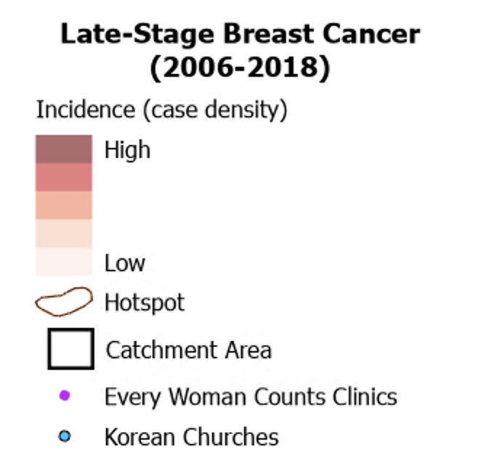
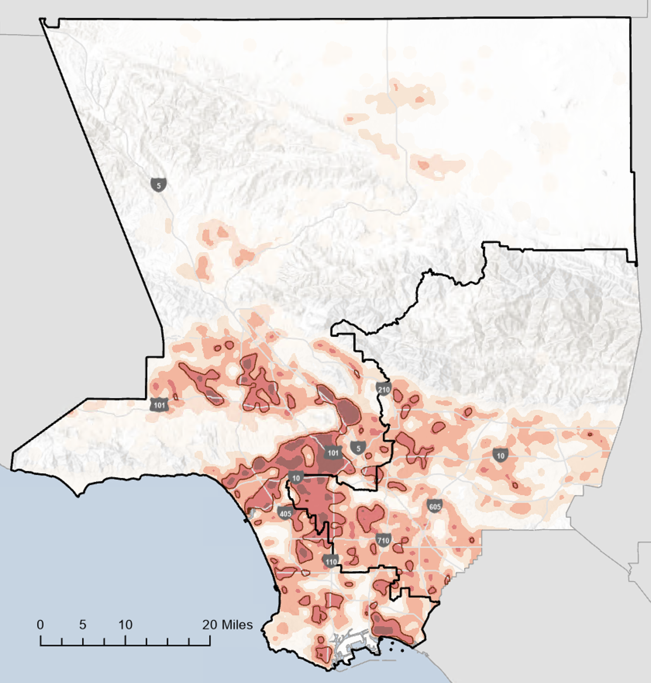
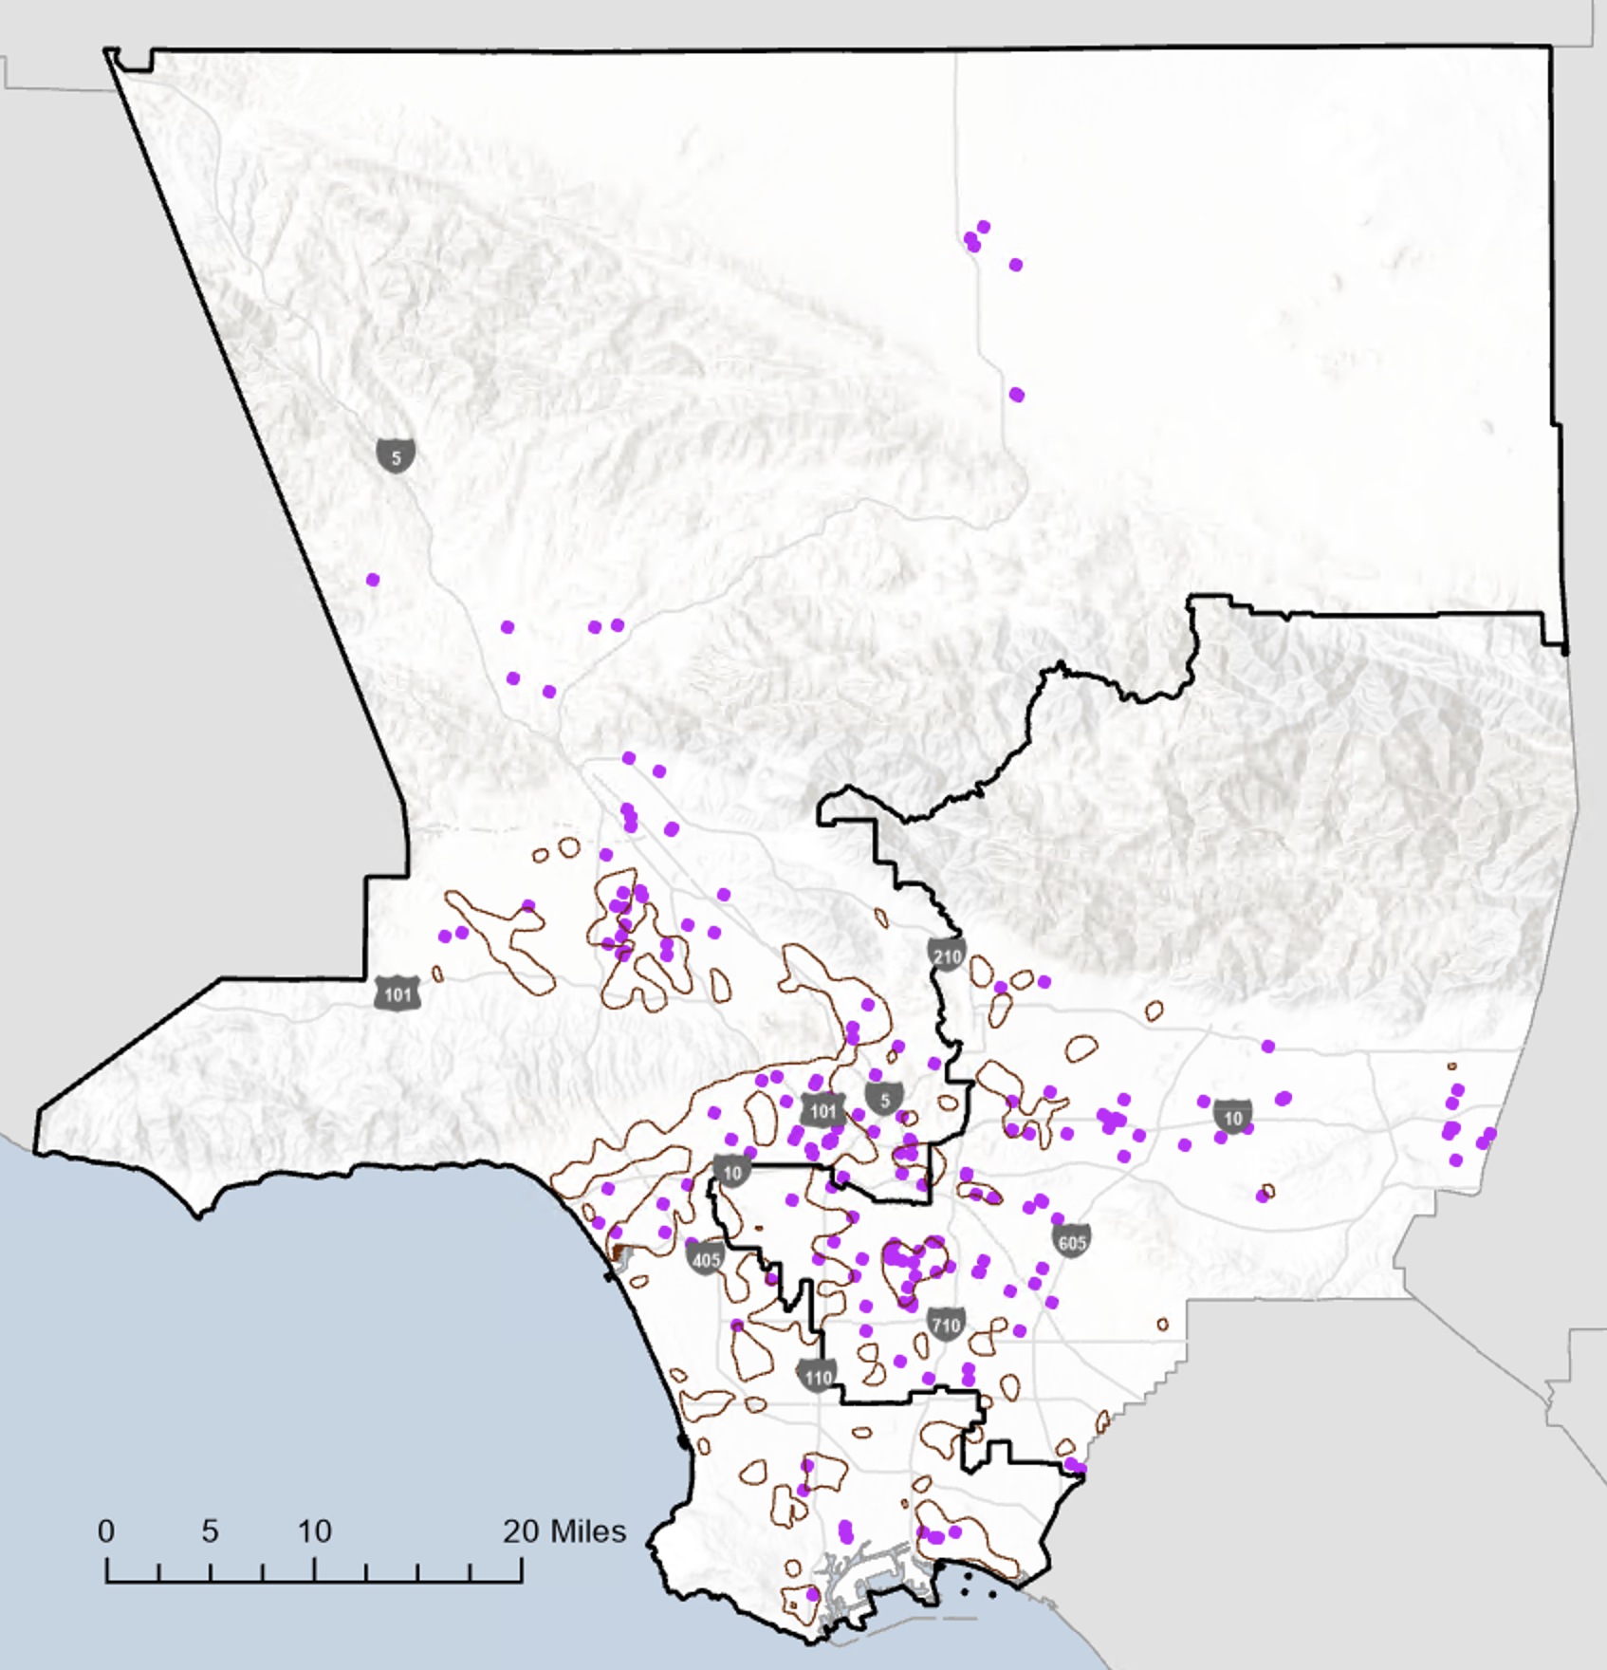
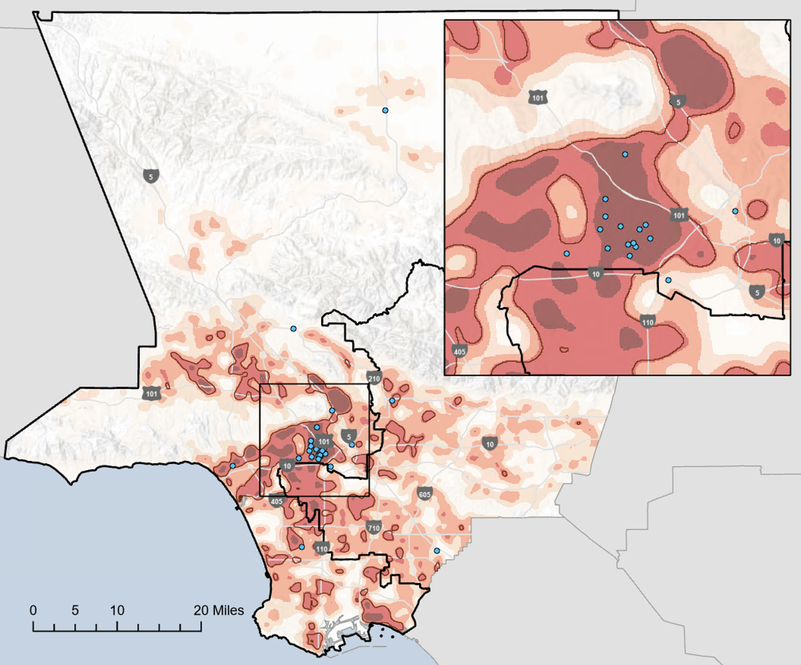

Geospatial analyses revealed geographic disparities in breast cancer and identified potential community partners
Heat Map of Late-Stage Breast Cancer
Hotspots + Free/Low-Cost Mammogram Clinics
Hotspots + Korean Churches
Cancer data came from the California Cancer Registry (2006-2018), SEER Site: 26000 (APR22 analytic file). Data were managed, analyzed and mapped in ArcGIS Pro by the Community Outreach and Engagement at Cedars-Sinai Cancer, in collaboration with the Los Angeles County Cancer Surveillance Program. Density distribution is based on the latitude and longitude of patients’ addresses at diagnosis. Areas with sparse data have been suppressed. Clinic data, provided by Every Woman Counts (EWC) is up-to-date as of 8/31/2022.
58
58

Slide 59
Use of cancer surveillance data to…
Support the alignment of need and tobacco control programs

Slide 60
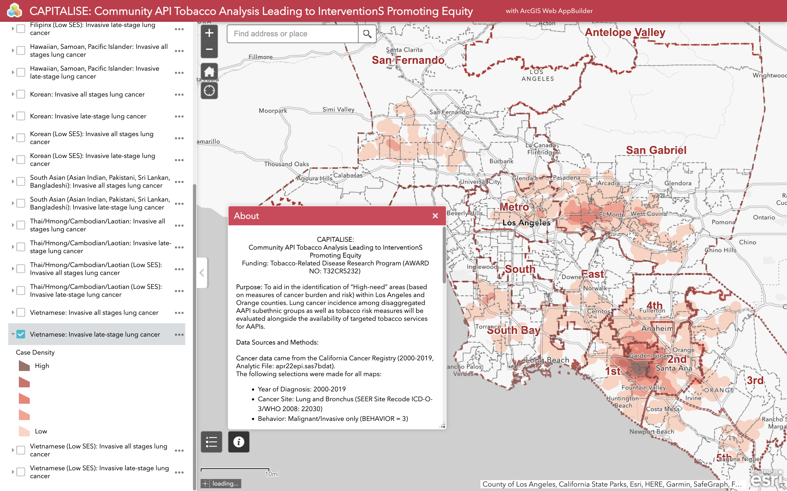
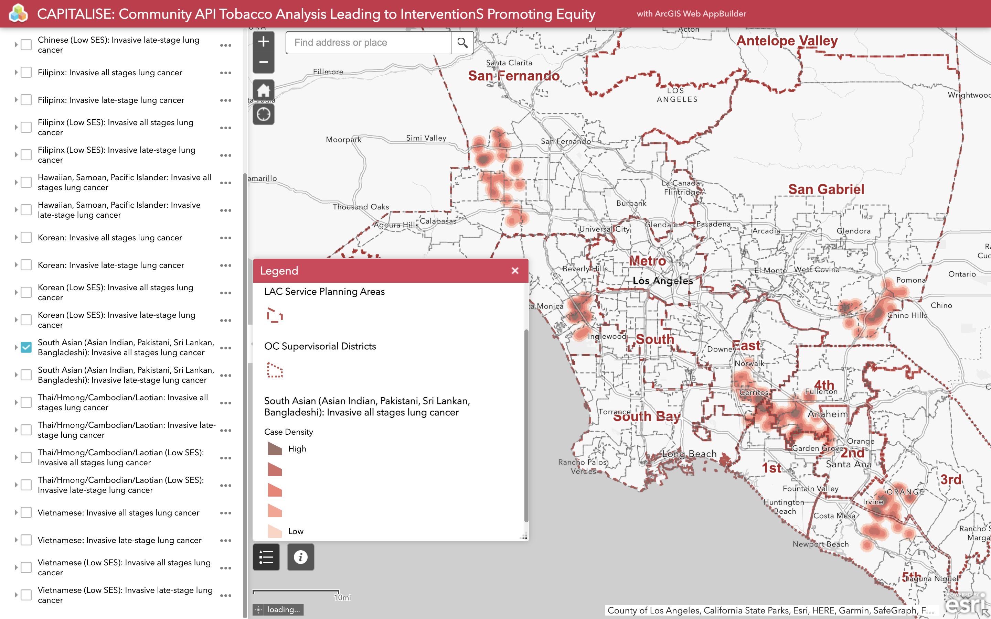
Community-Partnered Participatory Research Collaborative
Community API Tobacco Analysis Leading to InterventionS Promoting Equity (CAPITALISE)
Community-partnered participatory research (CPPR): power sharing and collaboration in all phases of research
    Community co-PI and Academic co-PI
    Community Advisory Board: Asian American and Pacific Islander (AAPI) coalitions
Understand the extent to which community-based tobacco control programs that predominantly serve AAPI:
    Are experiencing a misalignment in considering communities with the greatest needs, and
    Can be spatially optimized for the greatest risk reductions

Slide 61
Use of cancer surveillance data to…
Highlight the need for cancer data for populations with known risk factors and support equitable cancer care

Slide 62
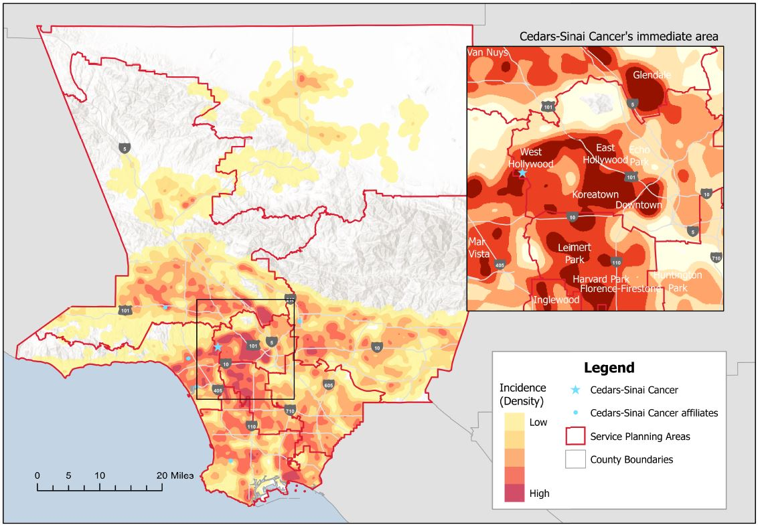
Cancer risk factors among LGBTQ+
Incidence of late-stage lung cancer, Los Angeles County, 2000-2019
Lung cancer
High rates of smoking compared to cisgender and heterosexual individuals
Breast cancer
Higher prevalence of risk factors: nulliparity, alcohol use, smoking, and obesity
Skin cancer
Indoor tanning were 2-6x more common among gay and bisexual
Colorectal cancer
Higher rates of obesity, alcohol use and smoking may all increase the risk in LGBTQ
HPV-related cancers
Anal cancer: Immunosuppression, smoking
Cervical cancer: misconceptions, obesity, alcohol use and smoking

Slide 63
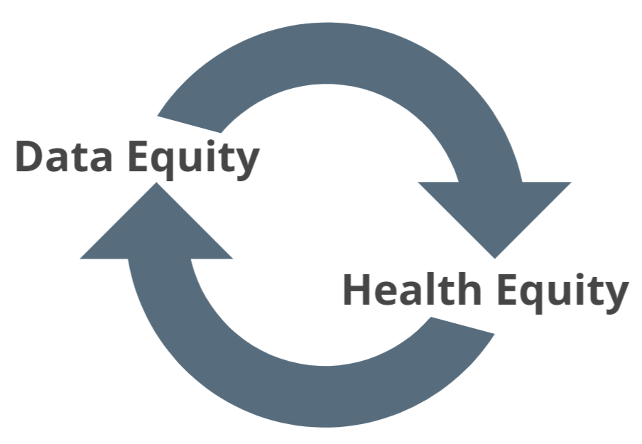
Cancer burden among LGBTQ+
Data limitation: unbiased estimates of cancer burden is not currently available due to the lack of sexual orientation and gender identity measures in population-based cancer registries
Sex/Gender Classification Workgroup (2021- )
    Properly code data based on the availability of information
    Support future research on the burden of special populations with known risk factors
    Support equitable cancer care
    Proposed an updated Sex data item and new Gender Identity data item
    The implementation of proposed changes, currently under review, would necessitate strong, ongoing collaborations among national standard setters, cancer centers, and community stakeholders
    NAACCR Data Dictionary:
    https://www.naaccr.org/data-standards-data-dictionary/
    Narrative: Sex/Gender Classification Workgroup:
    https://narrative.naaccr.org/article/sex-gender-classification-workgroup/

Slide 64
Panel Q&A

Slide 65
Patricia A. Ganz, M.D.
Health Policy & Management and Medicine
UCLA Fielding School of Public Health
Volunteer Awards
Round One
Kay Coleman
State Lead Ambassador
Mary Kemp
Director of Grassroots Organizing, California/Hawaii
ACS CAN
David Veneziano
Former Executive Vice President, West Region
American Cancer Society

Slide 66
Grand Champions of Hope
Abella Carroll
Mercy Campos
Landy Franck
Patsy Romero
Patsy Romero
Kate Clevenger
Vicky Herrera
Evelia Castillo-Rodriguez
Jose Ramos
Tracy Steuckrath
Lori Garcia

Slide 67
California Lights of Hope Top 10
P. Kay Coleman
Laura LaRose
Linda Shaner
Jamie Escoto
Kathy Flaherty
Ann Stangl
Tina Tankka
Margo Connolly
Dr. Ujwala Rajgopal
Bernie Glenn

Slide 68
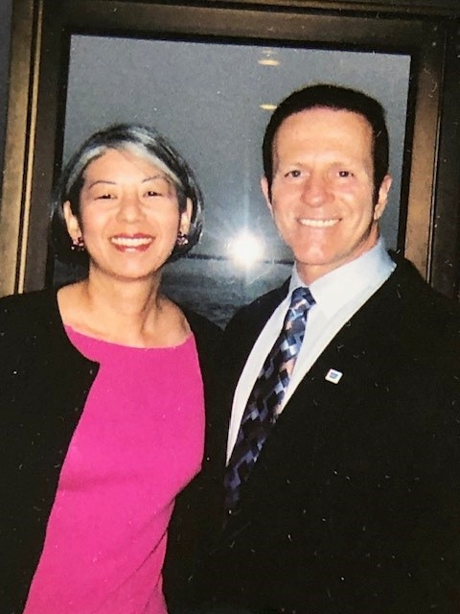

Slide 69
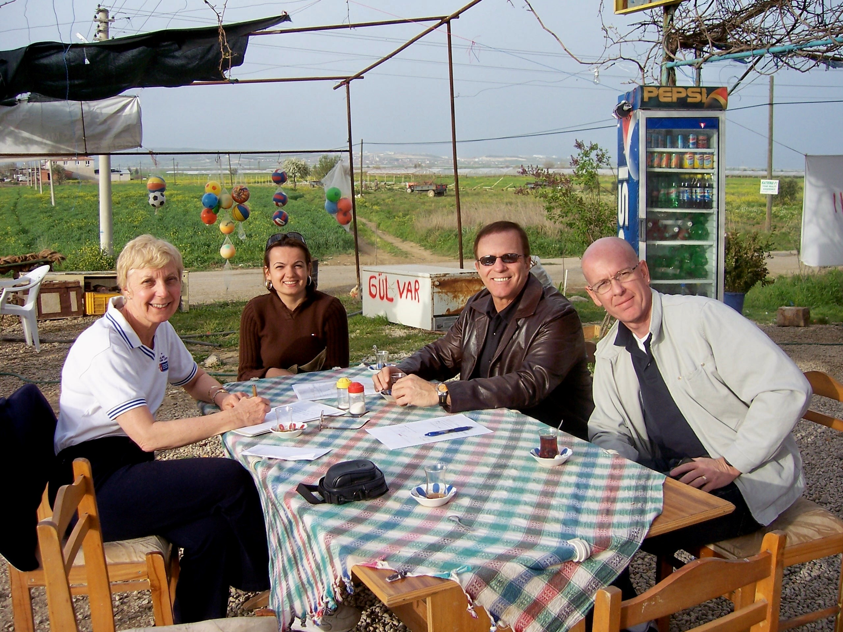

Slide 70
Survivor Speaker –
The Impact of
Biomarker Testing
Punita Khanna - Cancer Survivor
Donor Relations Manager
Westside Family Health Center

Slide 71
Enjoy YouR Lunch!
We will begin
again at 1:05

Slide 72
Patricia A. Ganz, M.D.
Health Policy & Management and Medicine
UCLA Fielding School of Public Health
Breakout Sessions
Round One
California Leading the Pack- Lights of Hope 2023 – Cabrillo
Hacks to Nail Your Next Media Interview– Sequoia
How ANYONE Can Engage Youth in Advocacy – Cel Lombard Boardroom
Tactics for Winning CA Priority Campaigns – Catalina
Why it Matters: Access to and Diversity in Clinical Trials – Mojave

Slide 73
WELCOME BACK
Kay Coleman
State Lead Ambassador

Slide 74
Patricia A. Ganz, M.D.
Health Policy & Management and Medicine
UCLA Fielding School of Public Health
Volunteer Awards
Round TWO
Kay Coleman
State Lead Ambassador
Mary Kemp
Director of Grassroots Organizing, California/Hawaii
ACS CAN

Slide 75
Patricia A. Ganz, M.D.
Health Policy & Management and Medicine
UCLA Fielding School of Public Health
Creating an Inclusive Volunteer Culture
Leslie Ferreira , MPA
Associate Director, Grassroots Alliances - Health Equity
ACS CAN
Gladys Arias , MPA
Principal, Health Equity Policy Analysis & Legislative Support
ACS CAN

Slide 76
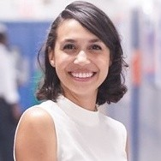
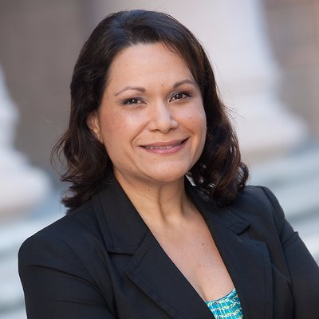
Building an Inclusive Volunteer Culture
Gladys Arias, MPA
(she/her/hers)
Principal, Health Equity Policy Analysis & Legislative Support
Leslie Ferreira, MPA
(she/her/hers)
Associate Director, Grassroots Alliance – Health Equity

Slide 77
ACS CAN Volunteer Diversity
Strategic engagement with partner organizations
Diversity, equity, and inclusion training opportunities
Building diverse champions
Creating and deepening leadership pathways for diverse volunteers

Slide 78
Inclusion Activity
What does inclusion mean to you?
Use the sticky notes at your table to write one word on what inclusion means to you.

Slide 79
Volunteer Experiences
Patsy Romero
Aditya Indla
Omar Gonzalez
Christine Flood

Slide 80


Slide 81
Principles of Inclusivity
Intentionality
Be reflective – What is the status of our current volunteer culture?
Be specific – Who do you want to engage?
Be authentic – Why do you want to engage them?

Slide 82
Principles of Inclusivity
Building trust
Connecting with gatekeepers
Listening, then acting
Showing up
Fostering long-term relationships

Slide 83
Principles of Inclusivity
Removing barriers
Reflection
Accessibility
Flexibility

Slide 84
Principles of Inclusivity
Centering the community
Values, culture, and language
Connectedness
Policy and advocacy work
Storytelling

Slide 85
Table Discussions – 15 minutes
What group or community would you like to explore or continue engaging?
What is ONE realistic step, tactic, or activity you have found successful, or you can do, to build a relationship with that group/community?

Slide 86
Reflections – 5 minutes
Please share the best idea you have heard today that you will explore.

Slide 87
Continuing the conversation
In your team meetings and planning sessions
Connect with the affinity groups

Slide 88
Lights of Hope Ceremony

Slide 89
Closing
Kay Coleman
State Lead Ambassador

Slide 90
Thank you
For joining
us today!
And for all you to advance policy changes that help end suffering and death from cancer.

