Slide 1
Utilizing Social Media to Fight Cancer

Slide 2
Index
Slide 1 – Why social media is important
Slide 5 – Terms
Slide 8 – Tagging
Slide 11 – Hashtags
Slide 15 – Facebook
Slide 24 – Twitter
Slide 29 – Just Great Examples

Slide 3
Why is Social Media Important
Both ACS and ACS CAN use Facebook and Twitter to spread policy, encourage participation, draw awareness to issues, hold lawmakers accountable and fundraise. By using these platforms, you can share ACS and ACS CAN with your family and friends.
Each platform has its advantages and disadvantages. Both can seem intimidating but, with a little practice, are actually very easy to use. So, let’s go over both and look at some examples.

Slide 4
ACS and ACS Can Social Media
Facebook:
ACS: American Cancer Society | Facebook
ACS CAN: American Cancer Society Cancer Action Network - ACS CAN Facebook
Twitter:
ACS: @AmericanCancer
ACS CAN: @ACSCAN
Almost every state will have its own Facebook or Twitter page. Check with your staff partner to get yours.

Slide 5
An Important Fact for Social Media!
If you don’t have a photo,
it didn’t happen!

Slide 6
Terms to Know
Over the next few pages, you will be seeing terms such as posting, tweeting, hashtag, tagging, sharing and retweeting. Let’s look at some definitions:

Slide 7
Terms to Know
Posting: putting information on your Facebook page
Sharing: taking someone else’s post and posting it on your page
Tweeting: putting information on your Twitter page
Retweeting: taking someone else’s tweet and tweeting it on your page
Hashtag: using a # in front of words to identify it as pertaining to a specific topic in a post or tweet
Tagging: using a @ in front of a name (person, business or organization) to let them know that you mentioned them in a post or tweet

Slide 8
On to Tags and Hashtags

Slide 9
What is a Tag or Tagging
On Facebook it can be done one of two ways:
1. Using a Facebook friend’s name in a post
2. Using a @ to “mention” someone’s Facebook page or profile in a post and linking to their page
On Twitter
Using someone’s Twitter username in a tweet

Slide 10
Why Tag?
Gets their attention! Anyone you tag will receive notification that they were mentioned.
Broadens reach of campaign. Not only will your friends see it, but their friends and anyone who follows a page you tag.
Holds Legislators publicly accountable. Legislators have staff who watch for the use of the Legislators name
Builds relationships with the person you tagged.
Gives them chance to respond (and get on the record!)

Slide 11
What Can Tagging Can Do
Volunteer Recognition: somebody does something special - let the world know
Thank: Everyone likes a thank you
Engage: Get people thinking about something
Relationship building: It can help get a conversation going with someone
Recognize a contributor or donor: if a company donates money or an item – let the world know
Lobby: Ask a legislator to support an issue

Slide 12
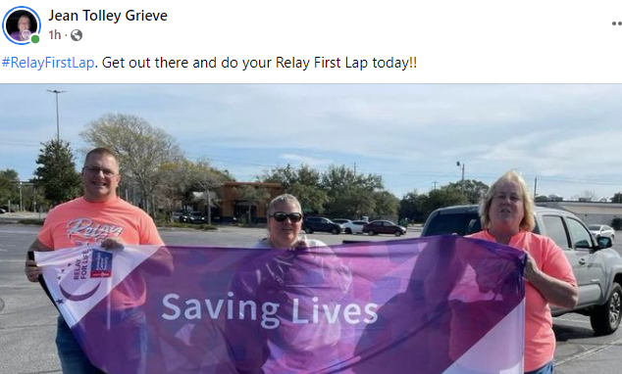
Hashtags
Hashtags are used to highlight events, causes or issues. They are also used to measure public interest in something which is commonly known as trending.

Slide 13
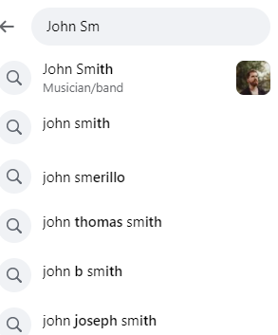
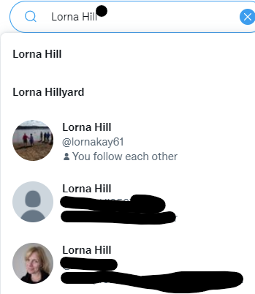
Ok – I Know How to Tag. How Do I Find People or Others I Want to Tag?
There are several ways to find people, either on Facebook and Twitter, or other sources.
1. Looking for people? Use the search bars.
Facebook
Twitter

Slide 14
Ok – I Know How to Tag. How Do I Find People or Others I Want to Tag?
2. Looking for a business? Go to their website and there should be a link there to their social media pages. Click on the link and you will be taken to that page.
3. If it is Facebook, click on “Like” and go back to your Facebook page. Now you will be able to tag them by using @ and their name.
4. The Facebook page will also have the name to use on Twitter.

Slide 15
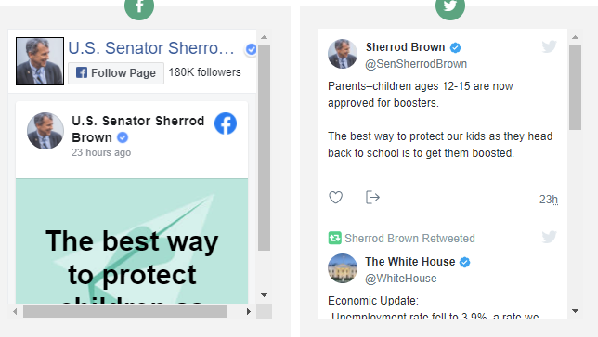
Ok – I Know How to Tag. How Do I Find People or Others I Want to Tag?
5. If you are tagging a legislator, you can go to their website, and they will have links to their social media that you can click on. Many legislators only use Twitter, so don’t be surprised if you don’t see any Facebook information.

Slide 16
Facebook
1.Great way to reach out to family and friends.
2. No restrictions on how big the post can be.
3. You have to accept friend requests, which can protect your privacy.
4. ACS and ACS CAN allow you to directly share to your page.
5. You can set up a separate page for fundraisers.
6. Not as many legislators use Facebook

Slide 17
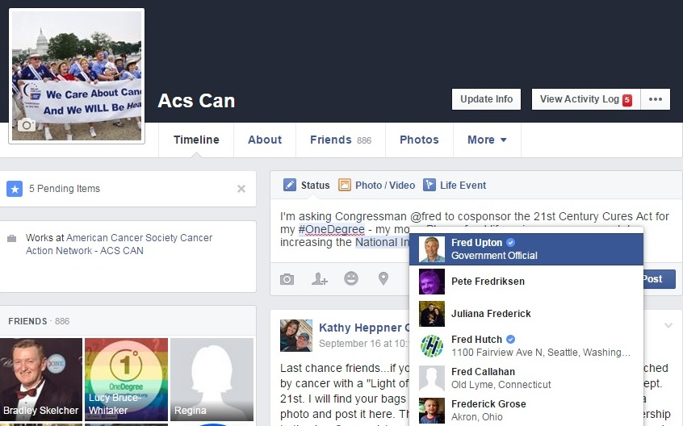
How to Tag on Facebook
Type in your post
When you reach the point where you want to tag, type @, then start typing the Facebook page name, the person’s name or the organizations name.
If you are tagging a legislator, be aware that some use “Rep”, “Senator,” or “Congressperson”.
A dropdown list will appear, and you just click on the correct name, and it will appear in your post.

Slide 18
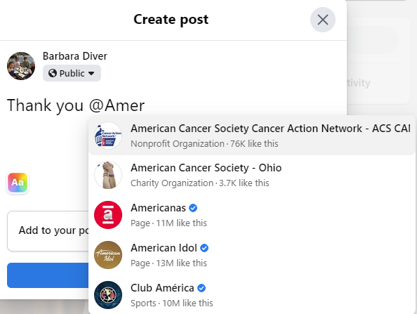
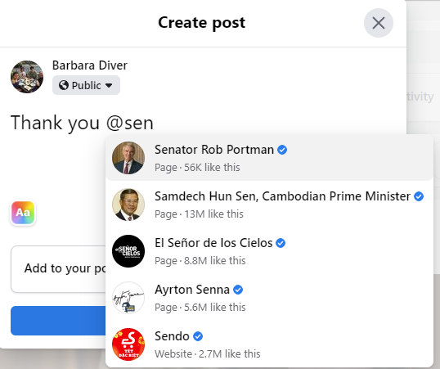
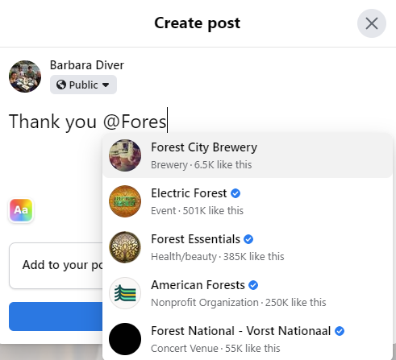
How to Tag on Facebook
Tagging a person
Tagging an organization
Tagging a business
Tagging a legislator

Slide 19
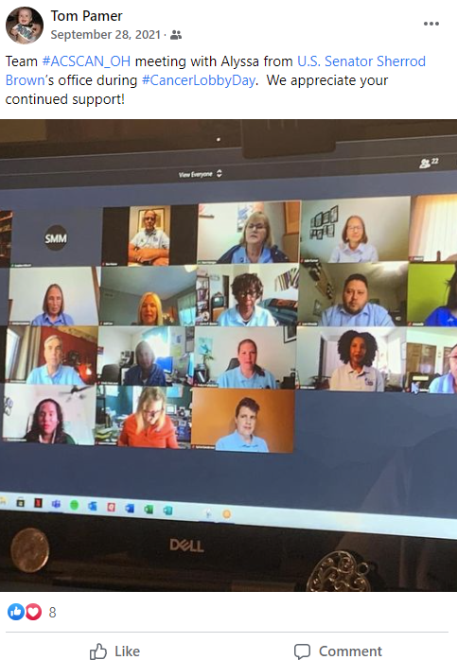
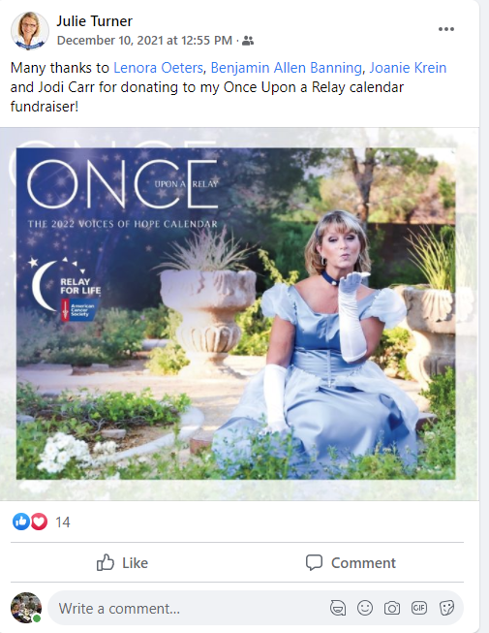
Facebook Post Examples
Post tagging a lawmaker to promote Cancer Lobby Day
Post promoting an ACS fundraiser

Slide 20
More Facebook Post Examples
An Event page set up in Facebook as a fundraiser.
You can also share any 3rd party fundraisers on Facebook with a link to a website for the fundaiser.

Slide 21
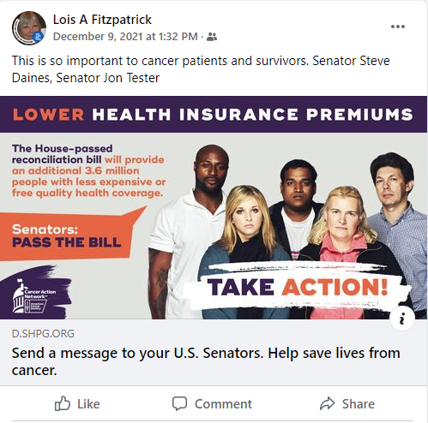
Sharing ACS and ACS CAN posts
Sharing of ACS RFL post
Sharing of ACS CAN action post

Slide 22
Facebook
How to share ACS and ACS CAN on Facebook:
Go to the Facebook page for ACS or ACS Can
Find the box that says “follow.” It will change to following as shown in the highlighted area.
Now you will get a notification when a post is made on the page you are following.

Slide 23
Facebook
When the page you are following has a post, you will receive a notification.
Click on that notification and it will take you to that post.
You can share it to your page by clicking on “share.”
4
5
6

Slide 24
Maximizing Facebook
The bottom line is that we need to be generating engagement with our posts
Commenting on or sharing posts, not just liking them
Tag a friend, fellow volunteer or lawmaker in comments
Notes:
Suggest that volunteer focus on our “win” posts. A bill passing out of committee, post asking governor to sign a bill, etc.

Slide 25
Twitter
1. Used by more legislators. This is a big one for ACS CAN posts.
2. You can reach more than just family and friends.
3. You can follow anyone
4. Anyone can follow you, so less privacy but larger reach for your posts.
5. Both ACS and ACS CAN allow you to share directly to your page
6. Restricted to use of 280 characters

Slide 26
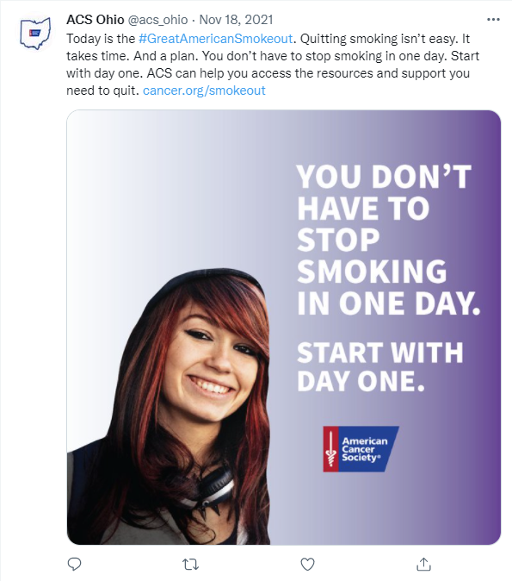
Twitter Examples
ACS tweet highlighting screening
ACS tweet promoting an event

Slide 27
Twitter Examples
ACS post retweeted
ACS CAN action tweeted from ACS CAN page

Slide 28
Twitter Examples
One of the great things about Twitter is that it will give you suggestions on who or what to follow tailored to what you Tweet and what your friends follow.

Slide 29
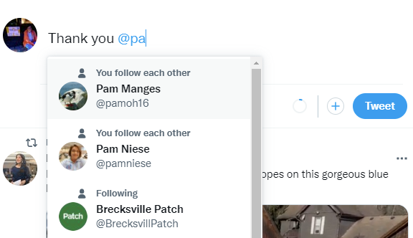
How to Tag on Twitter
This works like Facebook. Type in your tweet
When you get to the point you want to tag some one, type in @and the first few letters of their name and a dropdown will appear. Click on the correct name and it will appear in your tweet.
If you are tagging a legislator, be sure to use the correct tag. Sometimes they have several; one for official and one for campaigning. You want to tag the official one. Also put a .@ so the public will see your tweet.
Notes:
Twitter tagging walk through
Here’s an example of tagging a lawmaker’s handle (account) in a tweet. Make sure to type in your tweet, then add their handle (their name starting with the @ symbol) and then pick the right handle in the dropdown.
Once you’ve tagged their handle, it will show up in blue in your tweet.
Also, here are some tips to remember as you’re using this tactic:
Tips to discuss – final after screen shots
You need to double check if it’s the right type of account (office vs. campaign) – When you’re tagging, need to make sure of a few things. First, make sure it’s their official office account. It’s easy. Go to their .gov website and click on the icon for Facebook or Twitter. That’s their “official” page. No icon? Don’t tag. We’re trying to avoid tagging a campaign, which we are not supposed to do unless we’re doing electoral work through Cancer Votes.
.@ on Twitter – on Twitter, if you start a tweet with their handle or name, use a period before the handle to make the tweet public. If you don’t, only the lawmaker and you will see it.

Slide 30
Twitter Examples
Tagging legislators and hash tagging important issues
Tagging an issue partner, another post with an article to read and hash tagging an issue

Slide 31
Twitter Examples
Fundraiser page with a link to ticket sales and silent auction bidding site
A thank you

Slide 32
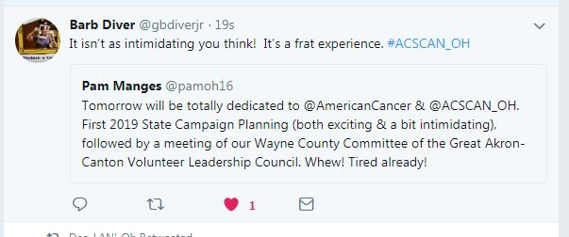
Just Great Examples

Slide 33
Just Great Examples

