Slide 1

Rhode Island
Cancer Action Day
Pre-event Training

Slide 2
Today’s Training
What is Cancer Action Day?
What to Expect
Issues Overview
Meeting with Your Lawmakers
Making the Asks
How to be a Successful Advocate
Promoting Cancer Action Day
Directions, Parking, and Other Tips
Questions?

Slide 3

What is Cancer Action Day?
Share your story and have YOUR VOICE HEARD
Thursday, March 26th

Slide 4
What to expect
Registration/Check-in
Stop by our registration desk to get your name tag, volunteer folder, and the leave-behind materials for your lawmakers.
Speaking Program
Hear from our legislative champions, partners, and fellow advocates.
Conversations with Lawmakers
Find your lawmakers to talk with them about our legislative priorities.
Report Backs and Thank You Notes
Return to the library to complete your report back forms and thank you cards for lawmakers.

Slide 5

Issue Overview
Eliminating Out-of-Pocket Costs for Diagnostic and Supplemental Breast Exams

Slide 6
Helping Rhode Islanders Access the Care They Need and Deserve
The Issue
Early detection of breast cancer reduces the chance of dying from the disease. While millions have coverage for screening mammography without cost sharing, individuals at a higher risk of breast cancer or those requiring follow-up imaging due to an abnormal screening mammogram result are subject to hundreds to thousands of dollars in cost sharing.
According to the National Cancer Institute’s Financial Burden of Cancer report, breast cancer has the highest treatment cost of any cancer.
Studies show that individuals facing high out-of-pocket costs associated with diagnostic and supplemental imaging are less likely to have the recommended follow-up imaging. This can mean that the person will delay care until the cancer has spread to other parts of the body making it more deadly and much costlier to treat.
What we can do
It is imperative that we take measures to reduce the overall costs to the health care system, ensuring breast cancer is detected at the earliest possible stage helps to eliminate the exorbitant treatments costs associated with a later stage diagnosis.

Slide 7
The Ask
Will you support S2032 and H7276 to eliminate out-of-pocket costs for diagnostic and supplemental breast exams?

Slide 8
Issue Overview
Eliminating Out-of-Pocket Costs for Follow-up Lung Cancer Screenings

Slide 9
Helping Rhode Islanders Access the Care They Need and Deserve
The Issue
Lung cancer remains the leading cause of cancer deaths in Rhode Island, while new cases (59.1 per 100,000) continue to outpace the national average (52.8).
Detecting lung cancer early can have a dramatic effect on survival. For non-small cell lung cancer, the most common lung cancer, the 5-year survival rate is 65% when found at a localized stage but only 9% when found at a distant stage.
Treating lung cancer at a later stage (Stage 4) is 254% more expensive than treating Lung Cancer at an early stage.
What we can do
It is imperative that we take measures to reduce the overall costs to the health care system, ensuring lung cancer is detected at the earliest possible stage helps to eliminate the exorbitant treatments costs associated with a later stage diagnosis.

Slide 10
The Ask
Will you support S3023 and H8246 to eliminate out-of-pocket costs for follow-up lung cancer screenings?

Slide 11
Issue Overview
Protecting Access to Patient Assistance

Slide 12
Helping Rhode Islanders Afford the Medications They Need
The Issue
Many of those living with cancer and other chronic conditions have difficulty affording the cost of their prescription drugs.
This is especially true for newer drugs – including cancer drugs – that do not yet have a generic equivalent.
To help ease the burden of high prescription costs, many of these individuals receive copay assistance offered through manufacturer and charitable patient assistance programs.
Copay accumulator adjustment programs allow enrollees to use copay assistance, but the amount of the support does not count towards the enrollee’s out-of-pocket cost sharing requirements, like their deductible.
This means that patients will see increased out-of-pocket costs and take longer to reach their required deductibles and out-of-pocket maximums.
Insurers, by using these harmful tools, are putting patients and their families in an impossible situation – having to choose between their health and paying their bills.
What we can do
Pass legislation that would require insurers to count all money paid by an individual - or on their behalf - toward their deductible or out-of-pocket responsibilities.

Slide 13
The Ask
Will you support S2253 and H7947 to protect access to critical patient assistance programs and help make medications more affordable?

Slide 14
Hook, Line and Sinker
Hook: Who You Are
Tell them who you are. Remember, you are a voter, a survivor/caregiver/advocate and their constituent.
Line: Share your stories and statistics
Be informative, be thorough and be concise. Provide your lawmaker with personal stories. They’ll appreciate real-life examples that put a human face on the issue. Discuss how the legislation will directly affect you, your friends, and your family. Personal stories truly make an impact and achieve results.
Sinker: The Request
Ask your legislator their position on the issue. Be polite, direct, and specific. Wait for their response.
Will you support S2032 and H7276 to eliminate cost-sharing for diagnostic and supplemental breast exams?
Will you support S3023 and H8246 to eliminate out-of-pocket costs for lung cancer screenings?
Will you support S2253 and H7947 to protect access to critical patient assistance programs and help make medications more affordable?

Slide 15
Being a Successful Advocate
Be yourself!
Remember you’re there to educate the lawmaker/their staff on the issue.
Don’t get distracted.
Don’t argue over policy issues and stay nonpartisan.
Thank legislator with a thank you card & follow-up email/call.
Complete report back forms.

Slide 16
After your meetings
Thank You Cards
Take a few minutes to write your lawmakers after your meeting. Cards are included in your packets and additional cards and pens will be available in the library.
Report Backs
Make sure to let us know how your conversations with lawmakers went by completing the online report back form.
We want you to stay involved with our Rhode Island team!
Become an ACS CAN member.
Join the team by becoming a legislative ambassador.
Join our virtual monthly meetings the 3rd Wednesday of the month.
Get involved with Lights of Hope, an annual event we hold in honor of all those impacted by cancer.

Slide 17
Logistics
Parking
There is street parking available. Parking is also available in the Providence Place Mall garage. Handicapped parking is available in the small parking lot on the east side of the building.
Entering the State House
Enter the State House from Smith Street. Please note that there are metal detectors at the State House entrance.
Visitors unable to use stairs may enter through the staff entrance accessed from the small parking lot on the east side of the building.
The State Library is located on the second floor.
Dress
Please dress in business casual attire and don’t forget to wear comfortable walking shoes. Wear your ACS CAN t-shirt from last year, if you have it.

Slide 18

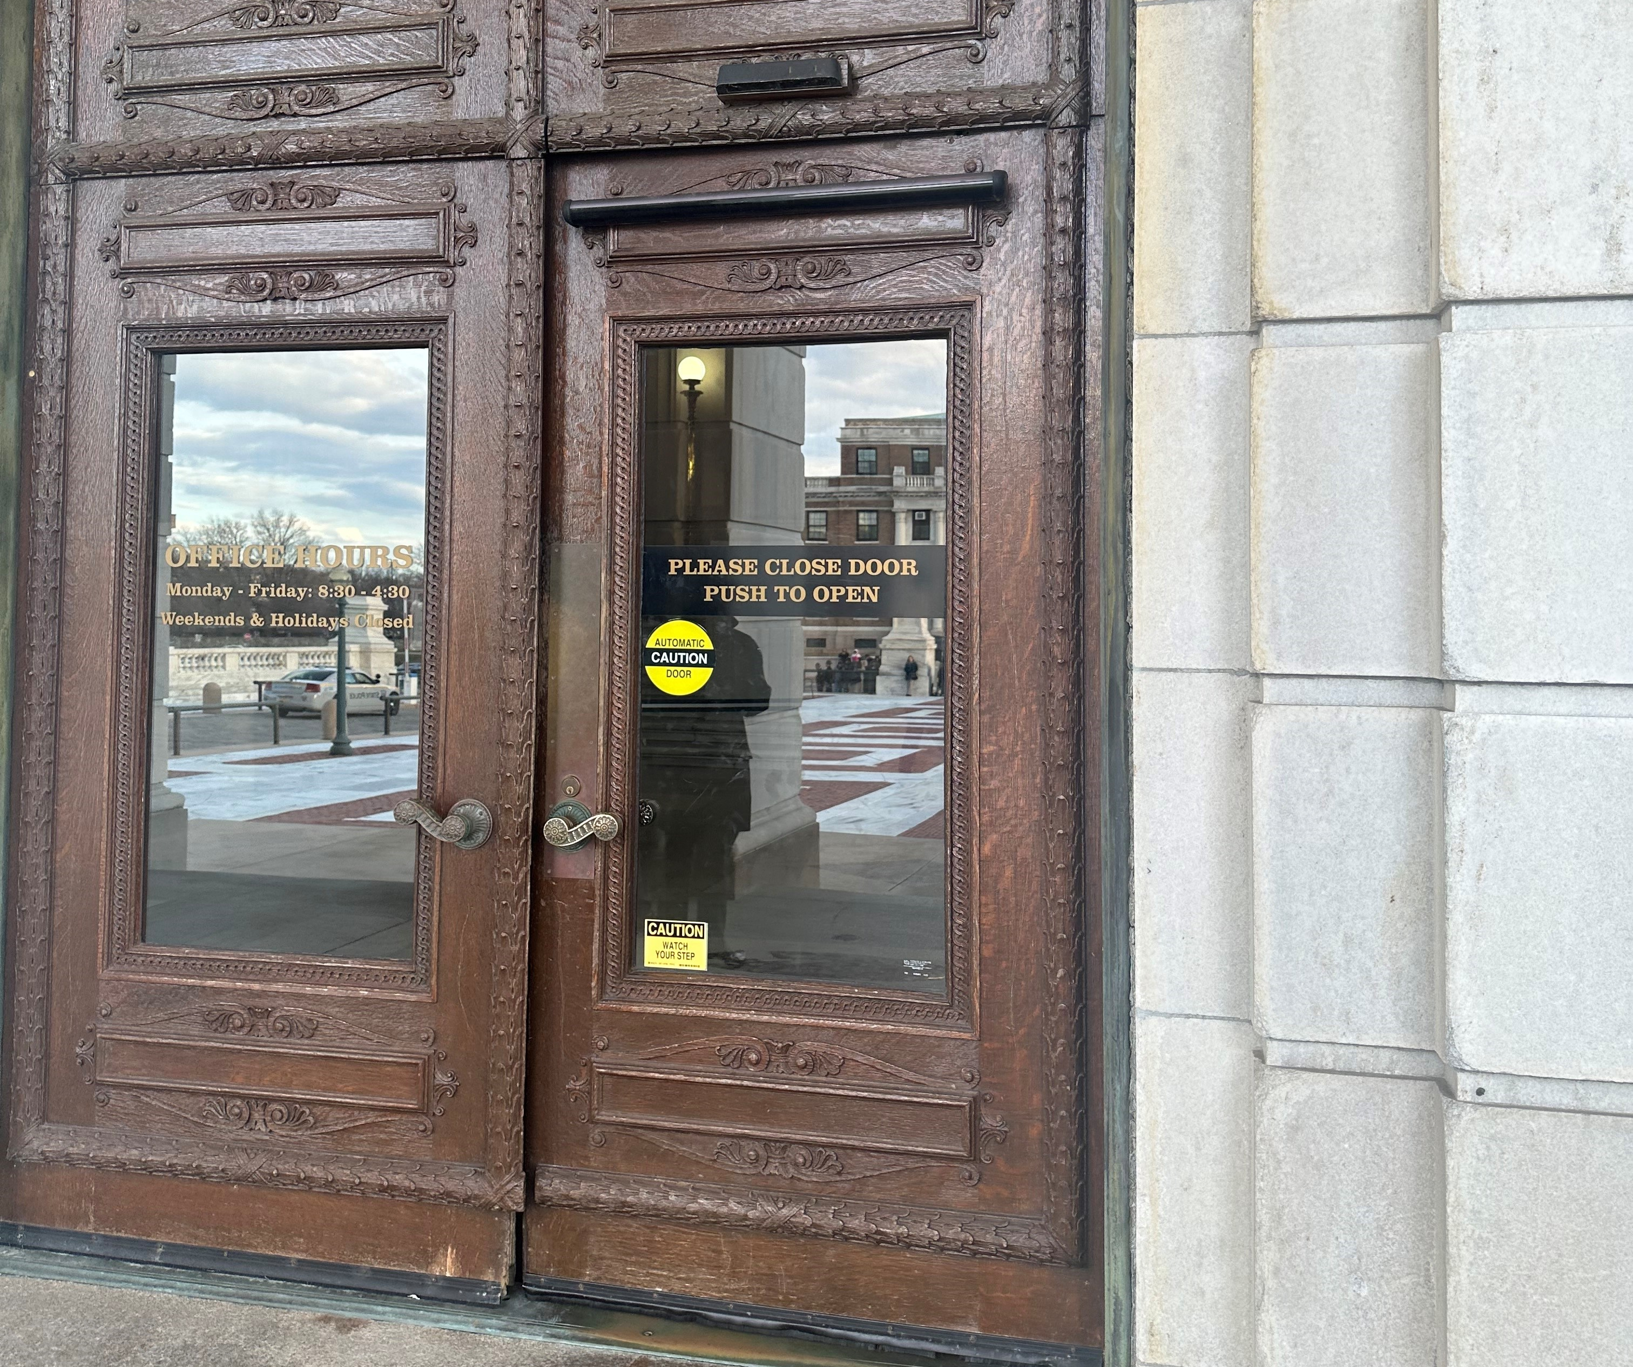
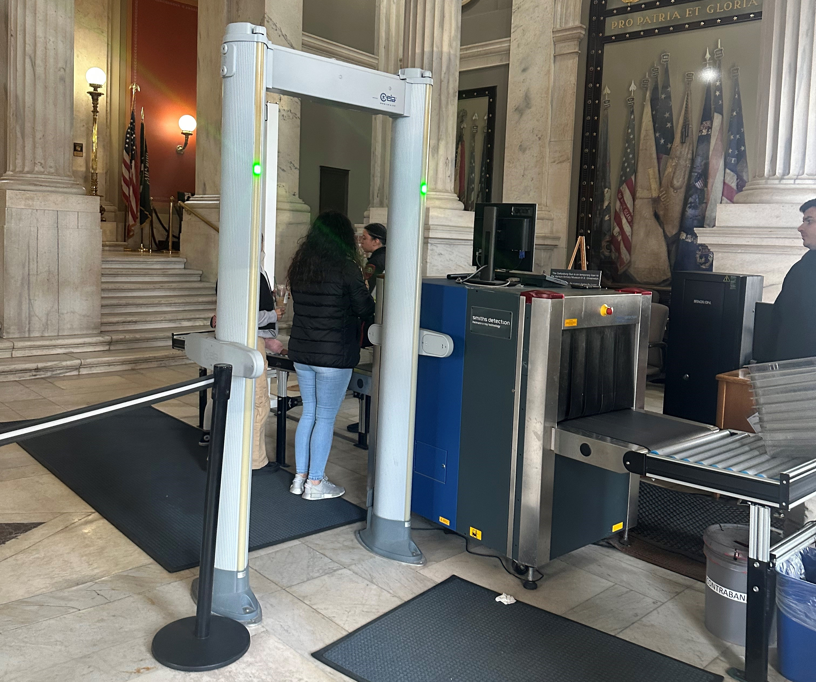



Entrance to the State House
Entrance to the State House
Security at State House
Stairs
Stairs
State Library

Slide 19


Promoting Cancer Action Day
Follow us on Social Media
Facebook.com/ACSCANRI
@ACSCANRI
Social Media Best Practices
Please take pictures!
Include hashtag #RICancerActionDay.
Include pictures in your posts.
Share and like your fellow volunteers’ posts and tweets.
Don’t wait, start posting now leading up to the event!
Check out the template posts in the training manual.

Slide 20
Questions

Slide 21

Thank You
©2022, American Cancer Society Cancer Action Network, Inc.

