Slide 1

2025
Illinois Cancer Action Day Training Guidebook

Slide 2

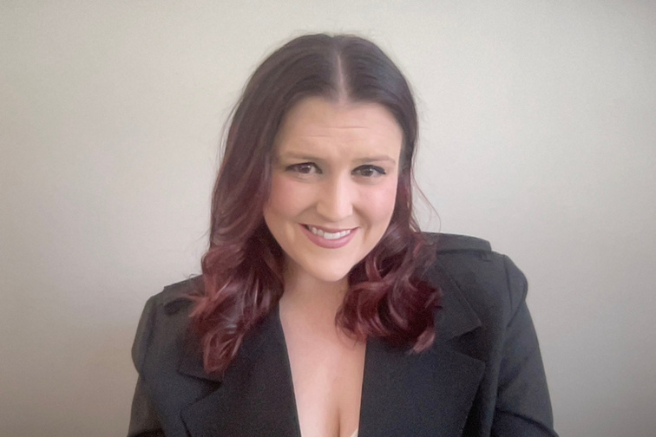
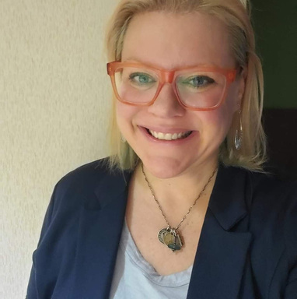
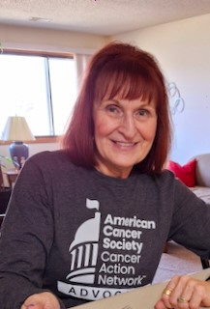
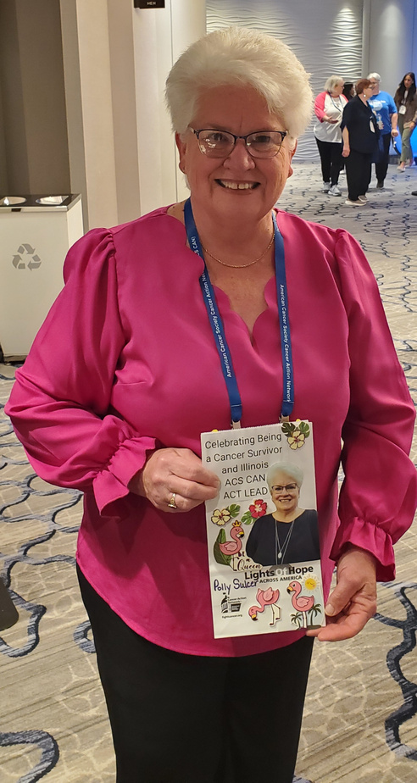

All Lopshire
Illinois Government Relations Director
Lauren MacLaren
Director of Grassroots Organizing
Maggie Powell
State Lead
Ambassador
Polly Sulcer
Vice State Lead
Ambassador
WHO WE ARE
Month Day Year

Slide 3
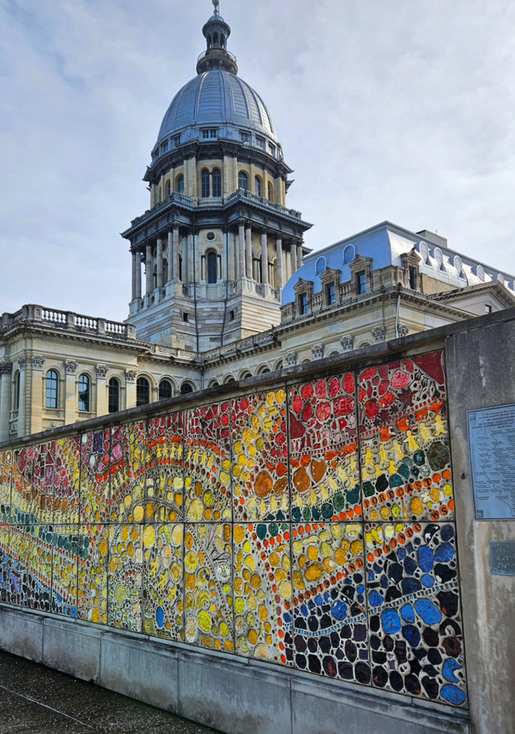

  What to Expect
  Do's and Don'ts
  Frequently Asked Q&A's
  Preparing for CAD
  Issue Overview/Our Asks
  Making the Asks/Meetings
  After Your Meetings
  Pre-Event Social Media
AGENDA

Slide 4
What to Expect
1
Check-In: 9:30-10:00 AM
Check-In will be from 9:30-10:00 AM at the Northfield Inn and Conference Center (3280 Northfield Drive, Springfield 62702 ), where you will receive your t-shirt, name tag and folders of materials. Give yourself extra time to park and get settled in.
2
Morning Kick-Off Presentation: 10:00 am - 11:00 am
Change in to your new t-shirt, find your table, meet and greet with your group. We will start our presentation at 10:00 AM sharp. There will be allotted time for your group to practice your asks before lawmaker meetings begin!
3
TIP
Don't be nervous! Cancer Action Day is a day for you to share your cancer story with your lawmakers.
Lunch
Boxed lunches will be available from 11:00 am - 11:45 am

Slide 5
What to Expect
4
Lawmaker Meetings: 12:00 pm - 3:00 pm
We'll head to the Statehouse by bus at 11:45 and meetings will start promptly at 12 pm/Noon.
5
Report Back
After each meeting, please make sure at least one person from your group completes the report back form. We'll provide a QR code for you to easily access the report back form from your smart phone, or you can use the paper copy report back forms available at the hotel.
6
Celebrate
Enjoy time with your fellow advocates! Take lots of photos, and celebrate the impact you just made. Don't forget to take a few minutes to write your lawmaker a thank you note and leave it with us to be delivered after our event.

Slide 6
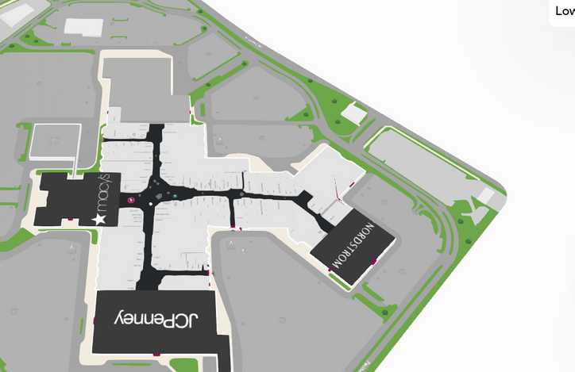
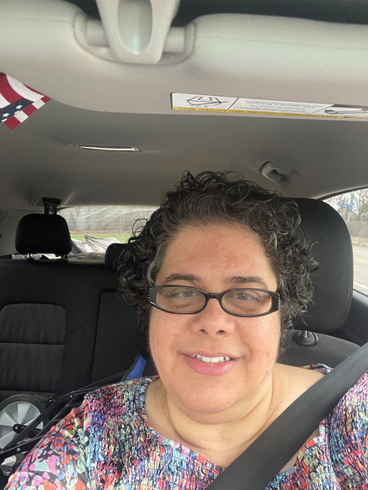

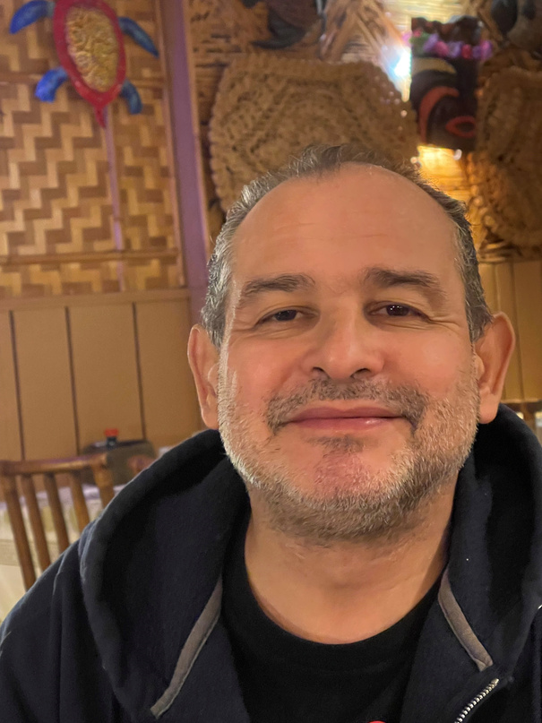
Taking the Bus from Schaumburg?
Woodfield Mall Schaumburg
Please arrive at Woodridge Mall by 6:00 AM as the bus will depart promptly at 6:30 AM. Free parking will be in the overflow lot by the Nordstrom parking garage. We have two bus captains, Theresa and Martin Mendez.
Bus Captains
Theresa Mendez
Martin
Mendez

Slide 7
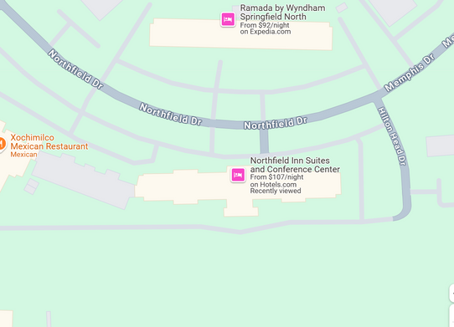
Parking at the Hotel
Northfield Inn and Conference Center
Parking is available for free at the Northfield Inn and Conference Center indicated with a star on the map. We will take a bus to the Illinois State Capitol for legislative meetings. The Statehouse is approximately 15 -minutes from the morning training location and parking around the capitol is traditionally challenging.

Slide 8
Do's and Don'ts
DO
DON'T
  Introduce yourself and share where you are from.
  Be on time (or early). Give yourself time to get through security.
  Stay on message.
  Know the name of the bill, the bill number and something about it.
  Be efficient, articulate and concise.
  Treat a legislative aide with the same respect and courtesy as a lawmaker.
  Ask for your lawmaker's support.
  Leave on a positive note and thank the lawmaker or their staff.
  Leave the lawmaker folder behind and ask to take a photo.
  Follow up with a thank you note.
  Attempt to answer questions you don't know the answer to or commit to anything you are not certain of.
  Miss any scheduled meetings.
  Mention your political affiliation.
  Lobby on other issues or discuss other organizations you are involved with.
  Get angry or hostile.
  Get defensive if a lawmaker doesn't support our legislation. Ask about their concerns and report them in the after meeting report back form.
  Leave behind or email any materials that aren't ACS CAN created or approved.
  Gather outside of the House Chamber.

Slide 9
Frequently Asked Q&A's
Q: If I'm the only participant from my district, will I be on my own to talk with my lawmaker or staff member?
A: No. Every volunteer is assigned to a group, so no one goes alone to a meeting.
Q: When will I learn who is in my group?
A: Group captains should reach out to you a week before Cancer Action Day to meet you virtually before travelling to Springfield.
Q: Do I need to attend the virtual Q&A training sessions if I have no questions?
A: Yes. We prefer you attend versus listen to the recording. Sometimes you don't know you have a question until someone else asks it. We will also share a lot of helpful information about Cancer Action Day and a more detailed overview of our legislative asks. If you are unable to attend the call on April 26, a recording will be provided and staff will be available via email for your Q&A.
Q: What if, at the last minute, I can't make my scheduled meetings?
A: If you have a last-minute availability change, please call/text Lauren MacLaren 330-524-0285
Q: What is the dress code?
A: The dress code for Cancer Action Day is business casual. You will pick up your t-shirt at check-in and have time to change before meetings. We recommend wearing khaki pants or a skirt. Our Cancer Action Day is also Suits and Sneakers Day at the Capitol. Please wear your favorite sneakers.
Q: Does it cost anything to attend Cancer Action Day?
A: No, our event is free! Registration is required in advance, though.

Slide 10
Preparing for Cancer Action Day
1
Mark Your Calendar and Attend our Q&A Call April 26
Our Cancer Action Day virtual Q&A training call will review event-day logistics, our legislative asks in detail and is a great opportunity to get your questions answered. This calls is highly suggested for each registered attendee. If there is a reason you're unable to attend the training call, please contact Lauren.MacLaren@cancer.org
  Saturday, April 26 at 10:00 am : Click here for the Microsoft Teams meeting
2
Research Your Lawmakers
New to Cancer Action Day and our ACS CAN advocacy efforts? Find your state lawmakers by entering your home address in the district maps below! Check out their bios, find their contact information, and even subscribe to their newsletters, if applicable. If you already have a relationship with your lawmakers, feel free to reach out and share how much you're looking forward to meeting with them or their staff on May 7.
Illinois House and Illinois Senate

Slide 11

Preparing for Cancer Action Day
3
Be Familiar with our "Asks"
We strongly encourage you to review our legislative requests in detail. Take some time to reflect on how your cancer story relates to these requests. We also recommend completing the "Hook, Line, and Sinker" worksheet by May 7, so you are prepared to discuss these issues with your lawmakers and coordinate speaking roles within your group. Please note that your group will be assigned prior to the event.
4
Get Ready!
Make sure you dress comfortably! Cancer Action Day is also Suits and Sneakers Day, please wear your favorite sneakers. Attire is business casual and your Cancer Action Day t-shirt will be available at check-in allowing ample time to change before the morning presentation and lawmaker meetings. Pack according to the weather (jacket, umbrella, sunscreen, etc.)
Please reach out with any questions, concerns, or last-minute cancellations.
Lauren.MacLaren@cancer.org or Ally.Lopshire@cancer.org

Slide 12
Contacting your lawmaker
1
Find your state rep and state senator
We would love it if you sent your state representatives a note that you are planning on attending Cancer Action Day May 7, and could either schedule a time to meet between 12pm - 3pm or pull them from the floor for a meeting at the rope.
But first, you need to find out who your representatives are:
Illinois House and Illinois Senate
2
Call and Email
While on our training on April 26, we will discuss what this outreach should look like and who will lead the outreach if there are more than one person in your group.
Sample phone/email script:
My name is XX and I am a constituent of Rep. XX and live in Chicago. I am traveling to Springfield on May 7 as part of the American Cancer Society Cancer Action Network’s Cancer Action Day and would like to meet with Rep. XX or a member of their staff between 12 pm and 3pm. Can I schedule that with you or does the representative prefer to be pulled from the floor?

Slide 13
Pre-event Social media
1
Pre-event social media
After you determine who your lawmaker is - either by asking Lauren.MacLaren@cancer.org or using the links below - tag them on a social media post announcing your attendance at Cancer Action Day. Choose one of the examples below for Facebook (make sure your post is public), Instagram or X.
Illinois House and Illinois Senate
2
Sample pre-event Social media
Sample social media:
I am traveling to Springfield @lawmaker for #ILCancerActionDay25 & #ILSuitsandSneakers with @acscanil on May 7. I am looking forward to meeting with you to discuss advancing policies that can save more lives from cancer.
I look forward to meeting with @lawmaker and/or their staff during #ILCancerActionDay25 in Springfield on May 7. I am makin the trip with dozens of volunteers to discuss advancing policies that can save more lives from cancer.

Slide 14
Issue Overview
1
Colorectal Cancer Screening
Our Ask: Will you support $1 million in state funding solely dedicated to colorectal cancer screenings and prevention across Illinois?
Why?
Colorectal cancer (CRC) is the third leading cause of cancer-related deaths in men and in women in the United States, and the second most common cause of cancer deaths when men and women are combined.
  Screening and early detection saves lives. When diagnosed early, the 5-year survival rate is about 90%. This rate drops to 13% when discovered in later stages.
  In 2025, approximately 6,110 people in Illinois will be diagnosed with colorectal cancer and 2,020 will die from this disease.
Funding Impact:
  Screen and address healthcare disparities statewide
  Encourage and educate people 45+ to get screened and know their risk factors
  Improve access to care in minority and rural communities

Slide 15
Issue Overview
2
Tobacco
Our Ask: Will you support taxing all tobacco product at an equal rate to cigarettes by cosponsoring SB 2338/HB 3606?
Why?
  It is important that the tax on all tobacco products be equivalent to the tax on cigarettes, otherwise if taxed at a lower rate, these products become an appealing alternative for price sensitive consumers, including youth. Other tobacco products include, but are not limited to, moist snuff, nasal snuff, loose-leaf and plug chewing tobacco, snus, dissolvable tobacco products, cigars, pipe tobacco, role-your-own tobacco, hookah, e-cigarettes, and nicotine pouches.
Why?
  18,300 Illinoisans die each year due to smoking related diseases.
  17.1% of high school students use tobacco products, including 3.6% who smoke cigarettes and 16.6% who use e-cigarettes.
  Increasing taxes on all non-cigarette tobacco products to an equivalent rate can generate new revenue, prevent kids from starting to use these products, and ensure that more people who use tobacco quit instead of switching to cheaper products.

Slide 16

Making the Ask- Hook, Line & Sinker
There are three key parts to a legislative meeting: the hook, the line and the sinker.
The hook, line and sinker strategy will help ensure you conduct effective and successful meetings with your lawmakers and/or their staff. In the meetings, you will have multiple lines and sinkers to match up with each of the asks of the day.
Determine as a group who will take which part of the meeting. Your group will have time to connect over lunch and on the bus to the statehouse. Use this time to finalize you plan and practice your meeting again.
Reminder - You will also have time during the morning presentation to practice!
TIP
A little small talk is good, but stay on message. You'll never know where the time went!
Use the Hook, line and sinker worksheet in the attachments to help organize your story for meetings.

Slide 17
The Hook - Starting the Meeting
We recommend the person from your group starting the meeting be a constituent of the district.
Introduce yourself and share why you are participating in Cancer Action Day. Decision makers want to hear from their local community, so sharing your name, hometown and other relevant information will help capture their attention.
Example:
My name is _______ and I am a volunteer with the American Cancer Society Cancer Action Network (if applicable: and I am also a constituent in your district). With me are constituents and advocates from around your district to talk about their cancer stories. Thanks so much for taking the time to meet with us today. During this meeting we would like to talk to you about some important issues impacting the fight against cancer in Illinois.

Slide 18
The Line, “your story” - Our Issues
Determine who from your group will make each line and sinker for our legislative asks
Be informative, thorough and concise. Lawmakers appreciate real-life examples that put a human face on the issue. Discuss the facts and how the legislation will directly affect you, your friends and your family. Personal stories truly make an impact and achieve results.
If someone in your group doesn’t have a story that directly aligns to the asks, don’t worry! You can say: “Let me tell you about my friend/relative/coworker/a patient...”
Example:
“Did you know that 17% of high school students in Illinois use tobacco products, and smoking costs the state $6.38 billion annually in health care costs​, including $2.04 billion in Medicaid costs​ alone? Significantly increasing tobacco taxes and investing in tobacco prevention and cessation programs is one of the most effective ways to prevent youth from starting to use tobacco and encourage those already addicted to quit. This is important to me because I have two children in junior high and high school and they tell me they already have multiple classmates who use tobacco products like vapes, which is quite alarming.”
“Colorectal cancer is caught early, the survival rate is around 90%. And yet, it is the second leading cause of cancer death for men and women combined, and more than 2,020 people in the state will die from it this year alone. The bottom line is screening and early detection saves lives.”

Slide 19
The Sinker - Make the ask
This is where we make the big ask and ask their position on the issue!
Say it with confidence and certainty. Be polite, direct and specific. Wait for their response. Whether they are in support or not, listen to their answer and learn what matters most to them about these issues. It is important to get a clear answer to provide on your report back form.
Example: "Will you/Can we count on [lawmaker’s name] support dedicated funding for colorectal cancer? Can we count on you to co-sponsor SB 2338 or HB 3606?"

Slide 20
Sinker Continued
Remember, we want to hear a YES or NO answer.
  If your lawmaker answers yes to the ask that is great! Thank them for their support.
  If your lawmaker answers no, ask why and if there is further information you can provide after the meeting.
    Include their concerns on your report back form.
  If your member doesn’t give a direct yes or no answer, ask for clarification.
  After you receive the answer, move on to the next ask (link and sinker).
After the first line and sinker, move on to the next until all legislative asks have been made and answered.

Slide 21

Closing the Meeting
Determine who from your group will close the meeting and thank the lawmaker/their staff.
This is the time to present the lawmaker/their staff with the leave behind folder provided to your group for each meeting.
Ask for a photo before you leave!
Example: "Thank you for taking the time to meet with us today! We appreciate your consideration and support of our asks/hope the [lawmaker name] will support our asks. Here is a folder with fact sheets and other detailed information on all the issues we discussed. We will make sure our Government Relations Director, Ally Lopshire, follows up to answer your questions. Do you mind if we took a photo together?”

Slide 22


After Your Meetings - Next Steps
1
Thank You Notes
Take a minute to write a thank you card. Thank you cards and sample messages will be provided! Please leave these in the appropriate basket at check-in.
2
Report Back
After each meeting, please make sure at least one person from your group inputs your lawmaker and/or their staff’s feedback and questions into the report back form using the provided QR code or hard copy version of the form. Please leave your feedback from at the registration table.
3
Share Photos/Post to Social Media
Post to social media using the hashtag #ILCancerActionDay25. Be sure to tag us and your lawmakers! We have lots of samples for you to use pre-, day-of and post-event. Make sure you are following us:
www.facebook.com/ACSCANIL
@acscanil
https://x.com/ACSCANIL
@@ACSCANIL
#ILSuitsandSneakers
#ILCancerActionDay25

Slide 23
Pre-event social media
Facebook, X, Instagram, Blue Sky, post where you have an account - tag a lawmaker if they have an account
Step one:
Take a picture of your sneaker or a selfie with your sneakers for an image.
Step two:
I am traveling to Springfield @lamwkaer for #ILCancerActionDay25 & #ILSuitsandSneakers with @acscanil on May 7. I am looking forward to meeting with you to discuss advancing policies that can save more lives from cancer.
I look forward to meeting with @lawmaker and/or their staff during #ILCancerActionDay25 in Springfield on May 7. I am makin the trip with dozens of volunteers to discuss advancing policies that can save more lives from cancer.
Step 3: Tag us!!!
Twitter/X: Tag @ACSCANIL
Facebook: Tag @ACSCANIL
#ILSuitsandSneakers
#ILCancerActionDay25

Slide 24
Don't Forget...
Our Cancer Action Day volunteer group will include attendees of all political persuasions.
The American Cancer Society Cancer Action Network is a nonpartisan organization.
Please notify Lauren MacLaren immediately (Lauren.MacLaren@cancer.org 330-524-0285) if for some reason you cannot attend Cancer Action Day.
TIP
Remember, lawmakers are people just like us!

Slide 25

THANK YOU!
©2022, American Cancer Society Cancer Action Network, Inc.

