Slide 1

Cori Chandler, MPA
Sr. Manager, State & Local Campaigns – Access to Care
Genetic Testing and Cancer Screening

Slide 2

Genetic Testing
Notes:
Genetic Testing For Inherited Risk For Cancer (youtube.com)

Slide 3
Genetic Testing
What is it? The testing of a person’s germline genes. This testing is typically performed using biospecimens such as blood or cells
Why do it?
Some families experience higher rates of cancer than others
Risk based on personal or family history of cancer
Informs cancer screening recommendations

Slide 4
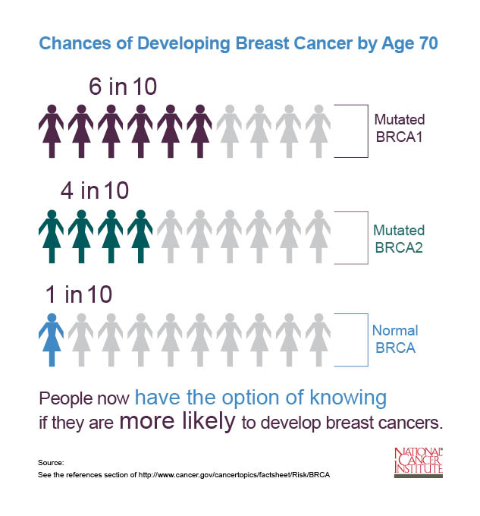
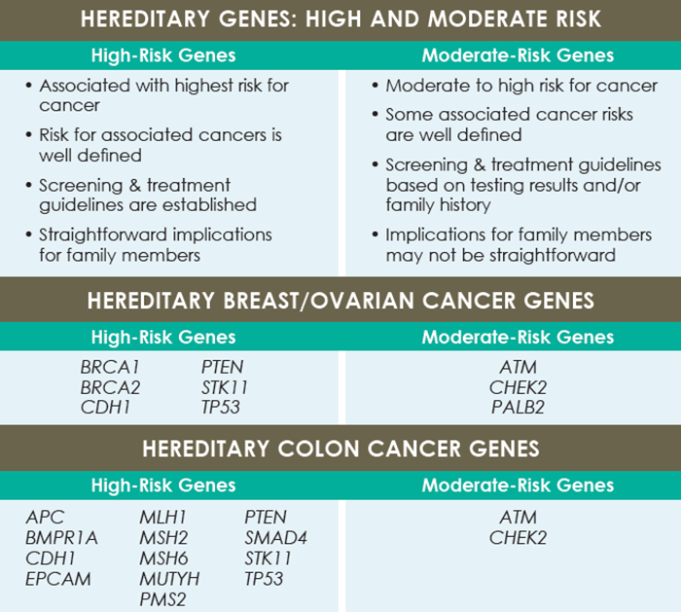
Hereditary Genes

Slide 5
Considerations of Genetic Testing
Benefits:
  Better understanding of cancer risks
  Inform blood relatives of potential cancer risks
Limitations:
  Testing can be expensive if not covered by insurance
  It does not always provide an answer about the cause of cancer within a family
Risks:
  Life, long-term care and disability insurers are permitted to use genetic and health information to make coverage and premium decisions

Slide 6
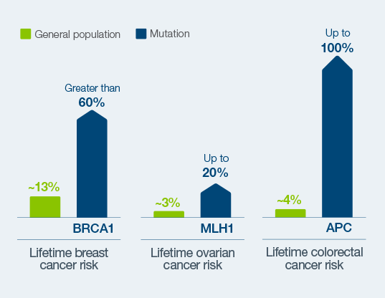
Results
  Positive for a mutation, negative for a mutation, “variant of unknown significance”

Slide 7
Insurance Coverage
Insurance Coverage for Genetic Testing
Most health plans cover genetic counseling and testing for inherited gene mutations linked to cancer in people who meet the national guidelines.
  The cost of testing and your out-of-pocket charges may vary based on several factors.
  Insurance Coverage for Genetic Testing
Insurance Coverage for Cancer Screening
Varies based on cancer type, typically according to national guidelines
Oftentimes states have laws that impact this coverage for state-regulated plans
How does the Affordable Care Act come into play?
Non-grandfathered private health insurance plans are required under the ACA to provide coverage of certain preventive services without cost sharing (according to USPSTF guidelines).
  Includes services that have an “A” or “B” recommendation rating from the USPSTF
    Lung cancer screening for certain adults – B grade
    Colorectal cancer screening for 45-75 – B grade
    Breast cancer screening for women aged 50-74 - B grade
    Genetic testing for BRCA – B Grade

Slide 8
Goal of SB1264
Ensure access to genetic testing
Allows those with a personal or family history access to genetic testing according to scientific and medical evidence
Access to necessary follow-up
Ensures individual has access to the appropriate follow up screening according to their risk
Eliminates cost-sharing for genetic testing and cancer imaging in accordance with NCCN clinical praction

Slide 9

Questions?

